Slide 1
Chapter 7
Intellectual Property Rights
Miller, Business Law Today Comprehensive Edition Text & Cases, 13th edition. © 2022 Cengage. All Rights Reserved. May not be scanned, copied or duplicated, or posted to a publicly accessible website, in whole or in part.

Slide 2
Chapter Objectives
By the end of this chapter, you should be able to:
Compare the laws that protect intellectual property, and their duration.
Differentiate between patents, copyrights, trademarks, and trade secrets.
List the required elements to prove infringement for each type of intellectual property.
Define first sale doctrine.
List the required elements to prove infringement for each type of intellectual property.
Describe the different international intellectual property treaties, and their purpose.

Slide 3
Why Does Internet Law Matter to Me?
The Internet impacts each of us, every day. The speed at which technology has advanced has presented challenges for the law to be able to keep up. To address these challenges, lawmakers have enacted several laws that solely address the Internet, like dealing with unsolicited e-mails or spam, domain names, cybersquatting and meta tags. It is important to have a general understanding of these laws and how businesses can protect themselves, and their intellectual property.
Notes:
Have students brainstorm how the internet and legal issues impact their everyday lives.
Answer: Responses will vary.

Slide 4
Trademarks
Trademarks and Service Marks
Catchy phrases
Abbreviations
Shapes
Ornamental colors
Ornamental designs
Sounds
Notes:
Trademarks are distinctive words, symbols, sounds, or designs that identify the manufacturer as the source of specific goods and distinguishes those goods from the products of others.
Question: Ask students if they think trademark protections should apply to similarities between noncompeting products.
Answer: Responses will vary.

Slide 5
Coca-Cola Co. v. Koke Co. of America (1920)
In this case, the United States Supreme Court made it clear that trademarks and trade names (and nicknames for those marks and names, such as “Coke” for “Coca-Cola”) that are in common use receive protection under the common law.
This holding is significant because it is the predecessor to the federal statute passed to protect trademark rights, the Lanham Act.
Notes:
In the Classic Case concerning Coca-Cola, the defendants argued that the CocaCola trademark was not entitled to protection under the law, because the term did not accurately represent the product.
The Lanham Act was enacted in part to protect manufacturers from losing business to rival companies that used confusingly similar trademarks. The Lanham Act incorporates the common law of trademarks, and provides remedies for owners of trademarks who wish to enforce their claims in federal court. Many states also have trademark statutes.

Slide 6
Coca-Cola Co. v. Koke Co. of America (1920)
Polling Question
Do you think the results of the case would have been different if Coca-Cola had been trying to make the public believe their product contained cocaine?
Yes
No
Notes:
Pose question to students, and discuss their responses.

Slide 7
Statutory Protection of Trademarks
Trademark Dilution
Federal Trademark Dilution Act of 1995
Trademark Dilution Revised
Trademark Dilution Revision Act (TRDA) of 2006
  Plaintiff owns distinctive famous mark
  Defendant uses mark allegedly diluting famous mark
  Association is likely to impair distinctiveness
Notes:
A famous mark may be diluted not only by the use of an identical mark, but also by the use of a similar mark, provided that it reduces the value of the famous mark. A similar mark is more likely to lessen the value of a famous mark, when the companies using the marks provide related goods or compete against each other in the same market.
The use of the similar mark (Sambuck’s) reduced the value of the famous mark (Starbucks). Starbucks Corp. v. Lundberg (2005)

Slide 8
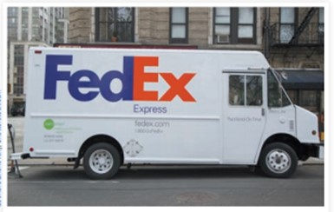
Trademark Registration
To register a trademark, a person must file an application with the U.S. Patent and Trademark Office.
A mark can be registered if in use, or mark will be used within 6 months.

Slide 9
Federal Express Corporation (FedEx) v. JetEx Management Services, Inc.
FedEx sued a competitor, JetEx Management Services, Inc., for using the same color combination and a similar name and logo.
JetEx also mimicked FedEx’s trademarked slogan (“The World on Time” for FedEx, and “Keeping the World on Time” for JetEx).
FedEx alleged trademark infringement and dilution, among other claims.

Slide 10
Federal Express Corporation (FedEx) v. JetEx Management Services, Inc. Polling Question
Do you think a company’s distinctive colors, such as those for FedEx, should be protected under trademark law?
Yes
No
Notes:
Invite students to discuss their reasoning with another person or classmate.

Slide 11
Distinctiveness of the Mark
Trademark Infringement
Copied Trademark
When a trademark is copied intentionally or unintentionally, it has been infringed or used without authorization.
Distinctiveness of the Mark
Strong Marks
Fanciful and arbitrary trademarks receive automatic protection.
Secondary Meaning
Certain terms and personal names are not inherently distinctive. They receive protection only when they acquire a secondary meaning.
Generic Terms
Generic terms that refer to an entire class of products receive no protection, even if they acquire secondary meanings.
Notes:
The most commonly granted remedy for trademark infringement is an injunction to prevent further infringement. Under the Lanham Act, a trademark owner that successfully proves infringement can recover actual damages, plus the profits that the infringer wrongfully received from the unauthorized use of the mark.
With strong marks: Suggestive trademarks indicate a product’s nature, quality, or characteristics without describing the product directly.
Secondary Meaning Case Example 7.2 Federal Express Corp. v. JetEx Air Express, Inc. (2017)
Distinctiveness of the Mark Case Example 7.3 Elliot v. Google, Inc. (2014) The court held that even if people do use the word google as a verb, it is still a protected trademark.

Slide 12
Service, Certification, and Collective Marks
Service mark: a trademark that is used to distinguish the services (rather than the products) of one person or company from those of another
Certification mark: a mark used by one or more persons, other than the owner, to certify the region, materials, mode of manufacture, quality, or other characteristic of specific goods or services
Collective mark: a mark used by members of a cooperative, association, union, or other organization to certify the region, materials, mode of manufacture, quality, or other characteristic of specific goods or services
Notes:
Example: The mark “CPA” is a collective mark used by members of the Society of Certified Public Accountants.
Notes: Collective marks appear at the end of a movie’s credits to indicate the various associations, and organizations that participated in making the movie.

Slide 13
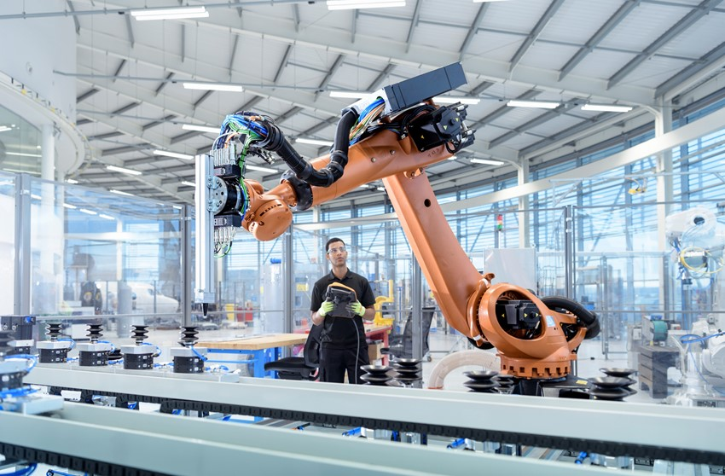
Trade Dress
Trade dress: the image and overall appearance of a product
It is a broad concept that can include all or part of the total image, or overall impression created by a product and its packaging.

Slide 14
Knowledge Check
Which of these are considered trade dress?
The distinctive decor, menu, and style of service of a particular restaurant
The layout and appearance of a catalogue
The use of a lighthouse as part of a golf hole, the fish shape of a cracker, or the G-shaped design of a Gucci watch
Notes:
Pose question to students.
Answer: All are correct. Basically, trade dress is subject to the same protection as trademarks. In cases involving trade dress infringement, as in trademark infringement cases, a major consideration is whether consumers are likely to be confused by the allegedly infringing use.

Slide 15
Counterfeit Goods
Counterfeit goods: copy or otherwise imitate trademarked goods, but are not genuine
Stop Counterfeiting in Manufactured Goods Act (SCMGA): it is a crime to traffic in counterfeit goods and services
Penalties for counterfeiting: up to $2 million or imprisonment for up to ten years (or more if they are repeat offenders)
Combating online sales of counterfeit goods: U.S. officials use court orders to shut down websites that sell foreign counterfeit goods
Notes:
Case Example United States v. Jones (2015) prescription drug.
Can the United States prosecute foreign counterfeiters under U.S. laws?
Invite students to discuss their reasoning with at least one other class member.
The United States cannot prosecute foreign counterfeiters under U.S. laws, because our national laws do not apply to them.
One effective tool that U.S. officials are using to combat online sales of counterfeit goods is to obtain a court order to close down the domain names of websites that sell such goods. Example 7.8 U.S. agents have shut down hundreds of domain names on the Monday after Thanksgiving (“Cyber Monday”). Shutting down the websites, particularly on key shopping days, prevents some counterfeit goods from entering the United States. Europol, an international organization, has also used this tactic.

Slide 16
Charles Anthony Jones
Charles Anthony Jones pleaded guilty to trafficking in counterfeit prescription drugs for erectile dysfunction.
The court sentenced Jones to thirty-seven months in prison, and ordered him to pay more than $600,000 in restitution.
Jones appealed, arguing that the amount awarded was more than the pharmaceutical companies’ actual losses.
The court agreed. The pharmaceutical companies were entitled only to their lost net profits, rather than the retail price of the genuine drugs.

Slide 17
Charles Anthony Jones Polling Question
Do you agree that the amount awarded was more than the pharmaceutical companies’ actual losses?
Yes
No
Notes:
Invite students to discuss their reasoning with another person or classmate.

Slide 18
Trade Names and Licensing
Trade Names | Licensing
Trade name: a name that a business uses to identify itself and its brand | License: agreement that permits use of trademark, copyright, patent, or trade secret for limited purposes
A trade name is directly related to a business’s reputation and goodwill. | The owner is the licensor, the user is the licensee.
Trademarks apply to products. | The terms of use are delineated in the license agreement.

Slide 19
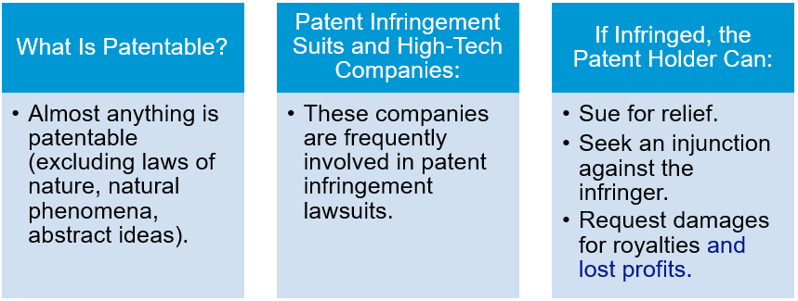
Patents
Notes:
Searchable Patent Databases-U.S. Patent and Trademark Office: www.uspto.gov
European Patent Office: www.epo.org
Case Example 7.9 West View Research, LLC v. Audi AG, Volkswagen AG (2017). West View Research, LLC holds numerous patents in a range of technologies, including speech recognition, wireless mobile devices, and medical devices. WVR filed a suit in federal court against several automakers, including Audi, Hyundai, Nissan, Tesla, and Volkswagen, alleging patent infringement.
Patent Infringement-Apple, Inc. v. Samsung Electronics Company and Cordance Corp. v. Amazon.com, Inc. (2010)

Slide 20
Remedies for Patent Infringement
If a patent is infringed, the patent holder can:
Seek an injunction against the infringer.
Request damages for royalties and lost profits.
Seek reimbursement for attorneys’ fees and costs.
If infringement was willful, amount of damages awarded can triple.

Slide 21
Discussion
John and Andrew Doney invented a hard-bearing device for balancing rotors. Although they obtained a patent for their invention from the U.S. Patent and Trademark Office, it was never used as an automobile wheel balancer. Some time later, Exetron Corp. produced an automobile wheel balancer that used a hard-bearing device similar to the Doneys’ device. Given that the Doneys had not used their device for automobile wheel balancing, does Exetron’s use of a similar device infringe on the Doneys’ patent? (See Patents.)
Notes:
Divide students into small groups, and give them the following instructions to analyze and answer this discussion prompt:
Notes: If a firm makes, uses, or sells another’s patented design, product, or process without the patent owner’s permission, it commits the tort of patent infringement. Patent infringement may occur even though the patent owner has not put the patented product into commerce.

Slide 22
Apple, Inc. v. Samsung Electronics Company
Apple sued Samsung in federal court alleging that Samsung’s Galaxy smartphones and tablets that use Google’s HTC Android operating system infringed on Apple’s patents.
Apple had design patents that covered its devices’ graphical user interface (the display of icons on the home screen), shell, screen, and button design.

Slide 23
Apple, Inc. v. Samsung Electronics Company Polling Question
Apple had also patented the way information is displayed on iPhones and other devices, the way windows pop open, and the way information is scaled and rotated.
No
Yes
Notes:
Invite students to discuss their reasoning with another person or classmate.
Answer: Yes
The Patent Act provision governing damages for design patent infringement encompasses both a product sold to a consumer, and a component of that product. Therefore, components of the infringing smartphones could be considered relevant to damages, even though the consumers could not purchase those components separately.

Slide 24
Copyrights
Federal statute grants to the author (or originator) of certain literary (or artistic) productions intangible property rights.
Works created after January 1, 1978, are automatically given copyright protection for life, plus 70 years.
Notes:
The popular character Sherlock Holmes originated in stories written by Arthur Conan Doyle (published from 1887 through 1927). Over the years, elements of the characters and stories created by Doyle have appeared in books, movies, and television series, including Elementary on CBS and Sherlock on BBC. Before 2013, those who wished to use the copyrighted Sherlock material had to pay a licensing fee to Doyle’s estate. Then, in 2013, the editors of a book of Holmes-related stories filed a lawsuit in federal court claiming that the basic Sherlock Holmes story elements introduced before 1923, should no longer be protected. The court agreed and ruled that these elements have entered the public domain—that is, the copyright has expired, and they can be used without permission.

Slide 25
Copyright Infringement
What Is Fair Use?
The courts determine whether a particular use is fair on a case-by-case basis.
Case Example: Authors Guild, Inc. v. Hathi Trust (2014)
The owner of a particular item that is copyrighted can, without the authority of the copyright owner, sell or otherwise dispose of it.
Notes:
What is “Fair Use” Exception?
In certain circumstances, the use of copyrighted material for the purposes of criticism, comment, news reporting, teaching, scholarship, or research is not an infringement of copyright.
The “Fair Use” Exception: Section 107 of the Copyright Act provides the following guidelines for determining fair use:
The purpose and character of the use
The nature of the copyrighted work
The amount and substantiality of the portion in relation to the copyrighted work as a whole
The effect of the use upon the potential market for, or value of the copyrighted work

Slide 26
Copyright Protection
Generally, copyright owners are protected against:
Reproduction of the work
Development of derivative works
Distribution of the work
But not public display of the work
Notes:
Invite students to discuss their reasoning with another person or classmate.
Answer: Even public display of the work is protected.

Slide 27
Google v. Oracle America, Inc.
Google began using some of Oracle’s API packages to run Java on its Android mobile devices, Oracle sued for copyright infringement.
Google argued that the software packages were command structure, which are not protected under copyright law.
Ultimately, a federal appellate court concluded that the API packages were source code and were entitled to copyright protection.
Notes:
Notes: The Computer Software Copyright Act amended the Copyright Act to include computer programs in the list of creative works protected by federal copyright law. Generally, copyright protection extends to those parts of a computer program that can be read by humans, such as the high-level language of a source code. Protection also extends to the binary-language object code, which is readable only by the computer, and to such elements as the overall structure, sequence, and organization of a program.
Facts: Oracle America, Inc., is a software company that owns numerous application programming interfaces, or API packages. Oracle grants licenses to others to use these API packages to write applications in the Java programming language. Java is open and free for anyone to use, but using it requires an interface.

Slide 28
Google v. Oracle America, Inc. Polling Question
Do you think Oracle was misusing the copyright in its proprietary software to stifle competition?
Yes
No
Notes:
Invite students to discuss their reasoning with at another person or classmate on the impact of API packages as source code.

Slide 29
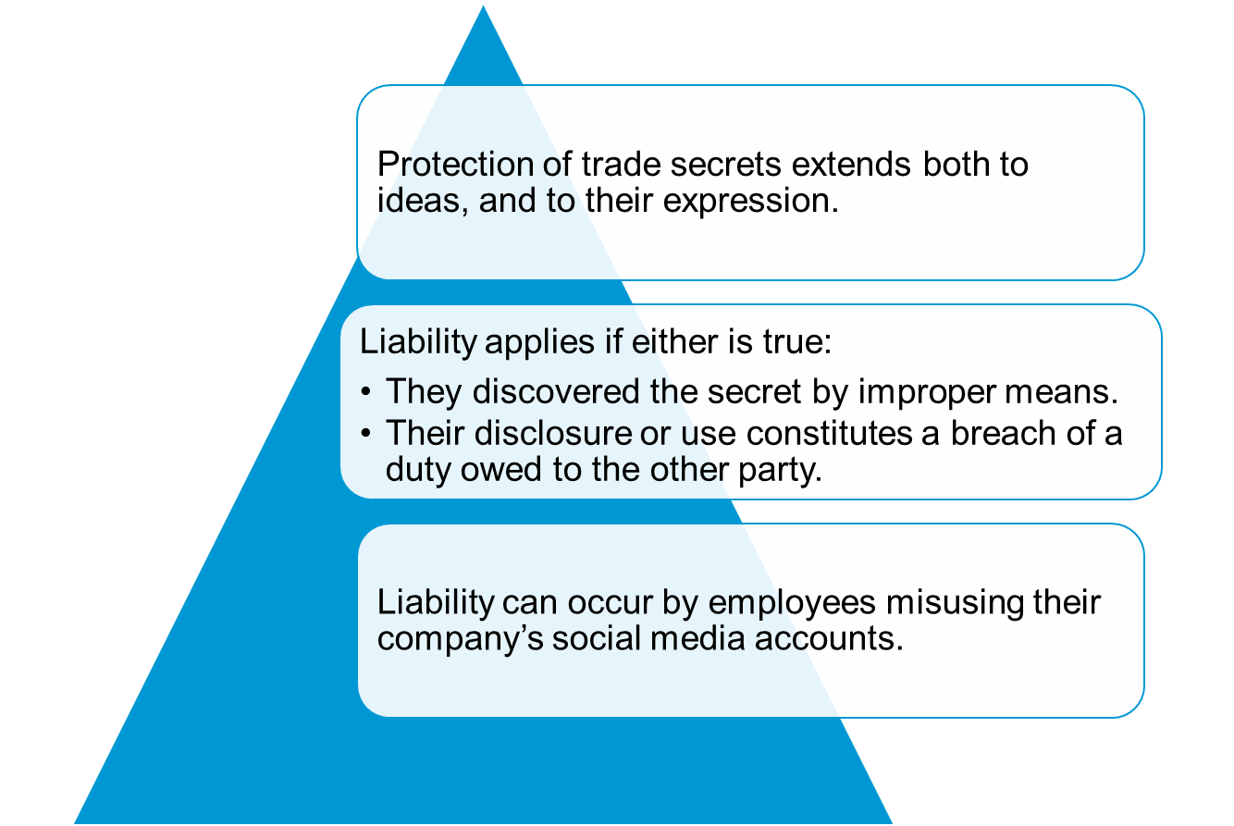
Trade Secrets in Cyberspace

Slide 30
Furstenau and BTX Logistics
Furstenau decided to join a competitor, BTX Logistics.
Before doing so, he forwarded e-mails containing information on revenues, profit margins, preferred shippers, and financial projections from his Radiant account to his personal account.
Learning this, Radiant sued Furstenau and BTX for misappropriation of trade secrets.
Notes:
Answer: A federal appeals court affirmed, with the caveat that Furstenau’s “general knowledge” of the logistics trade, as opposed to the specific data in the e-mails, did not constitute a trade secret.

Slide 31
Furstenau and BTX Logistics Polling Question
Does today’s computer technology undercut a business firm’s ability to protect its confidential information, including trade secrets?
Yes
No
Notes:
Invite students to discuss their reasoning with at another person or classmate.
For a summary of trade secrets and other forms of intellectual property, see Exhibit 7-1.

Slide 32
International Protections
The Berne Convention (1886)
Every country that has signed the convention must recognize copyrights from the other signatories.
The TRIPS Agreement (1994)
The TRIPS agreement established standards for the international protection of intellectual property rights.
Generally, the TRIPS agreement forbids member nations from discriminating against foreign owners of intellectual property rights in the administration, regulation, or adjudication of such rights.
Notes:
Additional International Protections:
The Madrid Protocol (2003)
U.S. company can submit a single application to register its trademark with all member nations.
The Anti-Counterfeiting Trade Agreement (2011)
Provisions and Goals: Increase international cooperation, facilitate the best law enforcement practices, and provide a legal framework to combat counterfeiting.
Border Searches: Member nations are required to establish border measures that allow officials to search commercial shipments of imports and exports for counterfeit goods.

Slide 33
How Does the TRIPS Agreement Protect Intellectual Property Worldwide?
Do international agreements like the Berne Convention, the Trade-Related Aspects of Intellectual Property Rights (known as the TRIPS agreement), the Madrid Protocol, and the Anti-Counterfeiting Trade Agreement protect intellectual property worldwide.
Yes
No
Notes:
Invite students to discuss their reasoning with at another person or classmate.
Congress has amended the Copyright Act several times. Copyright holders now have protection for many decades. Was Congress justified in extending the copyright time periods? Why, or why not?
Under ACTA, member nations are required to establish border measures that allow officials, on their own initiative, to search commercial shipments of imports and exports for counterfeit goods. The treaty neither requires nor prohibits random border searches of electronic devices, such as laptops and iPads, for infringing content. If border authorities reasonably believe that any goods in transit are counterfeit, the treaty allows them to keep the suspect goods, unless the owner proves that the items are authentic and noninfringing. The treaty allows member nations, in accordance with their own laws, to order online service providers to furnish information about (including the identity of) suspected trademark and copyright infringers.

Slide 34
Group Breakout: Spotlight on Macy’s—Copyright Infringement
United Fabrics International, Inc., bought a fabric design from an Italian designer and registered a copyright to the design with the U.S. Copyright Office. When Macy’s, Inc., began selling garments with a similar design, United filed a copyright infringement suit against Macy’s. Macy’s argued that United did not own a valid copyright to the design, and so could not claim infringement. Does United have to prove that the copyright is valid to establish infringement? Explain. [United Fabrics International, Inc. v. C & J Wear, Inc., 630 F.3d 1255 (9th Cir. 2011)] (See Copyrights.)
Notes:
Break students out into small groups, and have students discuss the questions posed on the slide.
Note: The courts determine whether a particular use is fair on a case-by-case basis.

Slide 35

Knowledge Check Video: Intellectual Property Infringement and Remedies

Slide 36
Discussion of Video
What is the name of the Government body that maintains records of copyright registration in the United States, including a copyright catalog?
Notes:
Answer: The United States Copyright Office, a part of the Library of Congress, is the official U.S. government body that maintains records of copyright. copyright.gov

Slide 37
Video Debrief
The Copyright Office has implemented a new group registration option for short online literary works, such as blog entries, social media posts, and short online articles. Read more about the new group registration option for unpublished works.
Notes:
You may register up to 10 unpublished works on the same application, but YOU MUST SELECT the new application for a “Group of Unpublished Works.”

Slide 38
Self-Assessment
What concepts did you find difficult, and thus need a review?
How might the topics in this chapter come up in the future in your personal (or work) life?
What could you do to improve your contributions in class discussion?
Notes:
Pose questions to students.

Slide 39
Summary
Now that the lesson has ended, you have learned to:
Compare the laws that protect intellectual property, and their duration.
Differentiate between patents, copyrights, trademarks, and trade secrets.
List the required elements to prove infringement for each type of intellectual property.
Define first sale doctrine.
List the required elements to prove infringement for each type of intellectual property.
Describe the different international intellectual property treaties, and their purpose.

