Slide 1
Chapter 4
Courts and Alternative Dispute Resolution
Miller, Business Law Today Comprehensive Edition Text & Cases, 13th edition. © 2022 Cengage. All Rights Reserved. May not be scanned, copied or duplicated, or posted to a publicly accessible website, in whole or in part.

Slide 2
Chapter Objectives
By the end of this chapter, you will be able to:
Differentiate between types of jurisdiction in state and federal courts.
Define venue and standing.
Define arbitration, negotiation, and mediation.
Describe the benefits of alternative dispute resolution.
Identify the types of claims are best settled by alternative dispute resolution.
Identify when a mandatory arbitration clause may have you struck down.

Slide 3
Why Do Courts & Alternative Dispute Resolution Matter?
Society needs an established method for resolving disputes.
Courts and alternative ways to resolve these disputes provide this for individuals and businesses in the U.S.
Judicial branch is one of the essential components of the American governmental system.
Role of judiciary is to interpret and apply the law.
ADR provides less expensive, and more efficient alternatives to litigation for resolving disputes.

Slide 4
The Judiciary’s Role in American Government
Judicial Review
Process where court decides on constitutionality actions taken by other two branches
Origins of Judicial Review in U.S.
“Judicial Review” is not mentioned in the U.S. Constitution
Marbury v. Madison

Slide 5
Landmark in the Law: Marbury v. Madison
Judicial Review
Doctrine of judicial review was establishing by Marbury v. Madison
Case involved review of executive branch action
Remains unchallenged, and is exercised by federal and state courts
Application today
  Constitutionality of federal statutes could not be challenged in court
  Statutes would remain in effect unless changed by Congress

Slide 6
Basic Judicial Requirements
Jurisdiction
  Court’s authority to hear and decide a case
Venue
  Appropriate physical location for a trial
Standing to Sue
  Plaintiff must have sufficient “stake” in the matter to justify seeking relief in court

Slide 7
Jurisdiction (1 of 5)
Jurisdiction over Persons or Property
  Authority to decide dispute involving person or business that resides in court’s geographic area.
  Long arm statutes
    Spotlight Case Example 4.2 – Ji-Haw Industrial Co. v. Broquet (2008)
  Corporations
    Case Example 4.3 – State ex rel. Norfolk Southern Railway Co. v. Dolan (2017)
Notes:
Case Example 4.2 - Ji-Haw Industrial Co. v. Broquet (2008)
Corporations are normally subject to personal jurisdiction in the state in which it is incorporated, has its principal office, and is doing business.
Case Example 4.3 - State ex rel. Norfolk Southern Railway Co. v. Dolan (2017)

Slide 8
Jurisdiction (2 of 5)
Jurisdiction over Subject Matter
  Authority of court to hear and decide certain types of disputes
  Probate court and bankruptcy court are two examples
  Trial court’s subject matter jurisdiction can be limited by:
    Subject of lawsuit
    Sum in controversy
    If case involves felony or misdemeanor
    If proceeding is a trial or appeal

Slide 9
Jurisdiction (3 of 5)
Original and Appellate Jurisdiction
  Example of original jurisdiction: trial courts or district courts
  Example of appellate jurisdiction: Court of Appeals reviewing prior decision in same case made by lower court

Slide 10
Jurisdiction (4 of 5)
Jurisdiction of Federal Courts
  Federal questions
  Diversity of citizenship
    Citizens of different states and
    Greater than $75,000 amount in controversy
  Case Example 4.4: Ratcliff v. Greyhound Bus Lines, 792 Fed.Appx. 121 (2nd Cir. 2020)
Notes:
Case Example 4.4: Ratcliff v. Greyhound Bus Lines, 792 Fed.Appx. 121 (2nd Cir. 2020)—party seeking to move a case to federal court from state court, bears the burden of demonstrating that the grounds for diversity exist.

Slide 11
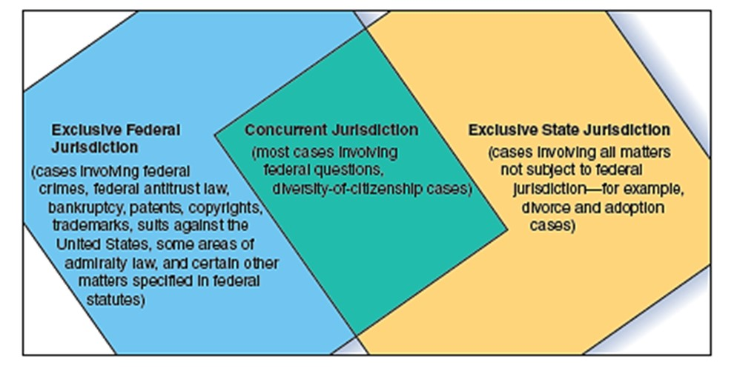
Jurisdiction (5 of 5)
Exhibit 4-1 Exclusive and Concurrent Jurisdiction

Slide 12
Jurisdiction in Cyberspace (1 of 2)
Jurisdiction of Federal Courts
  Courts use sliding scale standard
  Proper to exercise jurisdiction over out-of-state defendant who conducts substantial business on Internet
  Likely proper to exercise jurisdiction when some interactivity is done through website
    Case Example 4.5: Delahoussaye v. Boelter (2016)
  Never proper to exercise jurisdiction over defendant engaging in passive online advertising

Slide 13
Jurisdiction in Cyberspace (2 of 2)
International Jurisdictional Issues
  Use of Internet raises international jurisdictional issues
  Courts around world developing standard akin to minimum-contacts requirement used in U.S.

Slide 14

Video: The Stages of a Trial
Notes:
Pose question to students.
Answer:

Slide 15
Knowledge Check Video Activity
List and describe the five stages of a trial.
Notes:
Voir dire
Opening statement
Presentation of the case
Closing argument
Jury activity

Slide 16
Video Debrief
Discuss some examples of instructions that a judge may give to a jury.
Notes:
Burden of proof
Applicable rules of law
Evidence that may no longer be considered
Invite students to brainstorm their own examples.

Slide 17

Gucci America, Inc. v. Wang Huoqing (2011)
Chinese resident, Huoqing, was selling counterfeit Gucci items online.
Gucci filed a trademark infringement against Huoqing in a California federal district court.
Legal issue: Can U.S. federal court exercise personal jurisdiction over a Chinese resident whose only contact with U.S. was through an interactive website that advertised and sold counterfeit goods?
Court held that it did indeed have personal jurisdiction over Huoqing.
Notes:
Case notes:

Slide 18
Gucci America, Inc. v. Wang Huoqing (2011) Discussion Question
  What if the facts were different?
    Assume Gucci had not presented evidence that Huoqing made one actual sale through his website to a resident living in the Northern District of California.
    Would the court still have found it had personal jurisdiction over Huoqing? Why, or why not?
Notes:
Divide students into small groups, and have them discuss and answer the discussion prompts.

Slide 19
Venue
Civil case: typically where defendant resides
Criminal case: typically where crime occurred
Pretrial publicity can lead to request of change of venue
The Internet and 24/7 news reporting has diminished the significance of venue

Slide 20
Standing to Sue
Threshold requirement to bring a lawsuit
Plaintiff must have sufficient “stake” in the matter
Suffered a harm–e.g., physical injury or economic loss
Case Example 4.6: Wagner v. CitiMortgage, Inc., 995 F. Supp. 2d 621 (N.D. Tex. 2014)
Notes:
Wagner v. CitiMortgage, Inc., 995 F. Supp. 2d 621 (N.D. Tex. 2014): plaintiff Wagner obtained loan from M.S.T. Mortgage Group to buy a house in Texas. M.S.T. transferred its interest in loan to another lender, who assigned it to another lender. Wagner defaulted on the mortgage and CitiMortgage notified Wagner it was going to foreclose on the house. Wagner sued claiming lenders had improperly assigned the mortgage. Court ruled Wagner lacked standing to contest the assignment—the parties directly involved in the assignment are the only parties that can challenge its validity (the two lenders).

Slide 21
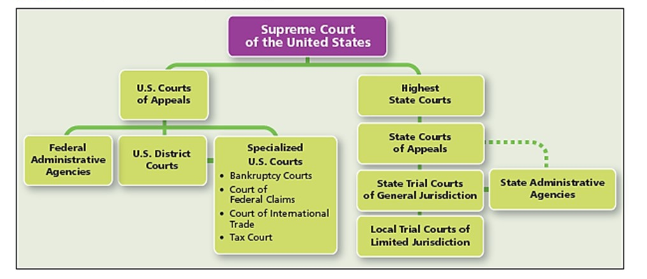
State & Federal Court Systems
Federal Courts and State Courts are Independent Systems
Exhibit 4-2 The State and Federal Court Systems

Slide 22
State Court Systems
  Trial Courts
    Entry-level court where trials are held and testimony taken
    Judge or jury makes determination based on facts
  Appellate Courts
    Reviewing courts that review questions of law, rather than questions of fact
    Defer to trial court’s findings of facts, unless the findings are erroneous
    State’s highest court has final determination on questions of state law

Slide 23
Oxford Tower Apartments, LP v. Frenchie’s Hair Boutique (2020) Polling Question
Should an appellate court’s review of the trial court’s damage award amount be subject to the principle that limits appellate review of other evidence?
Yes
No
Why, or why not? Explain your reasoning to one other person.
Notes:
Students’ discussion should discuss the award, and the extent to which the appellate court should be able to review and rule on the damage amount.

Slide 24
Federal Court System (1 of 2)
U.S. District Courts
  Entry-level courts equivalent to state trial courts of general jurisdiction
U.S. Courts of Appeals
  13 U.S. Courts of Appeals (Circuit Courts)
U.S. Supreme Court
  9 Justices
  Review any case decided by federal courts of appeals
  Appellate authority over some state court decisions
  “Rule of Four”
Notes:
Discuss also the Rule of Four, which requires that at least four Supreme Court justices agree that a case merits review.
Petitions for writ of certiorari are typically granted when case raises important constitutional questions, or lower courts have conflicting decisions on a significant issue (“split in the circuits”).

Slide 25
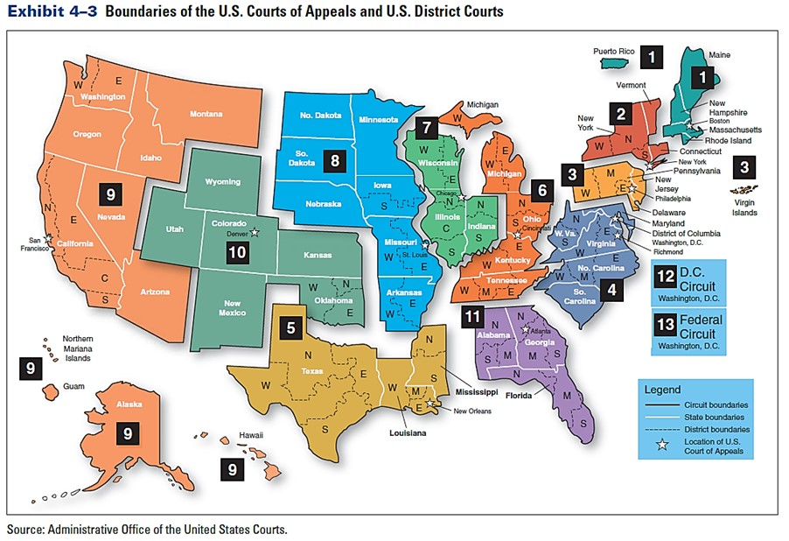
Federal Court System (2 of 2)
Exhibit 4-3 Boundaries of the U.S. Courts of Appeals and U.S. District Courts
Source: Administrative Office of the United States Courts.

Slide 26
Following a State Court Case
The pleadings
Complaint
Service of process
Default judgment
Defendant’s answer
  Counterclaim
Reply

Slide 27
Pretrial Motions
Motion to dismiss
Motion for judgment on the pleadings
Motion for summary judgment

Slide 28
Discovery (1 of 4)
Method by which opposing parties obtain information from each other
Various methods used to obtain information
Information used to prepare for trial

Slide 29
Discovery (2 of 4)
Depositions
Interrogatories
Case Example 4.10 Construction Laborers Trust Funds for Southern California Administrative Co. v. Montalvo

Slide 30
Discovery (3 of 4)
Requests for Information
  Admission of truth
  Documents and other items
  Entry upon land

Slide 31
Discovery (4 of 4)
Electronic discovery
E-Discovery procedures

Slide 32
Pretrial Conference
It’s an informal discussion between judge and lawyers.
The purpose is to explore possibilities of a settlement, identifying the real issues in dispute, and planning the course of the trial.

Slide 33
Jury Selection
Trials can be with or without a jury (bench trial).
Seventh Amendment guarantees the right to jury trial in federal cases, that is if the amount in controversy exceeds $20.
Voir dire is the process of jury selection.

Slide 34
At the Trial
Closing Arguments and Awards
  After the defense concludes presentation, both sides present their closing arguments.
  Judge instructs the jury in the law that applies to the case.
  Jury retires to the jury room to deliberate a verdict.
  If jury finds for the plaintiff, it will also decide on amount of the award.
Notes:
Jury award: monetary compensation given to a party at the end of a trial, or other proceeding.

Slide 35
Posttrial Motions
Motion for judgment n.o.v.
Motion for new trial

Slide 36
The Appeal (1 of 2)
Filing the Appeal
  Lawyers argue case on appeal using briefs (written summaries explaining each side’s case) and oral argument.
Appellate Review
  Affirm the trials court’s decision
  Reverse the court’s judgement
  Remand (send back) the case to trial court
  Partly affirm or reverse a decision
  Modify the lower court’s decision

Slide 37
The Appeal (2 of 2)
Appeal to Higher Appellate Court
  Losing party may appeal intermediate appellate court’s ruling to the jurisdiction’s supreme court equivalent
  New round of briefing and oral arguments occur
Enforcing the Judgment
Plaintiff who wins damage award has no guarantee of collecting it from defendant.
Notes:
Example of difficulty enforcing the judgment—Nicole Brown and Ron Goldman’s families unable to obtain a full damage award in civil suit against O.J. Simpson.

Slide 38
Courts Online and Electronic Filing
Courts today have websites that contain information for the public
In some states, court clerks offer information about the court’s docket
Many offer searchable databases online
Many state and federal courts allow parties to file legal documents electronically with the court
Federal Court System’s electronic filing system (CM/ECF) is accessed through PACER (Public Access to Court Electronic Records)

Slide 39
Cyber Courts & Proceedings
Litigants may be able to use cyber courts where judicial proceedings take place online
Electronic courtroom projects have already been developed in some federal and state courts
COVID-19 pandemic forced several courts to hold proceedings remotely

Slide 40
Alternative Dispute Resolution
Resolution of disputes in ways other than those involved in the traditional judicial process.
  Unless court-ordered, ADR has no record, an important factor for companies in commercial litigation trying to keep trade secrets hidden.
  Most common forms of ADR: negotiation, mediation, and arbitration.

Slide 41
Negotiation
Simplest form of ADR
Used in variety of ways to attempt to settle dispute informally
Parties without attorneys can negotiate
Attorneys representing each side can negotiate
Purpose is to avoid additional cost of litigation

Slide 42
Mediation
ADR method uses neutral third party to mediate dispute.
Mediators propose a solution, but it is not binding on parties.
Case Example 4.12: Business partners

Slide 43
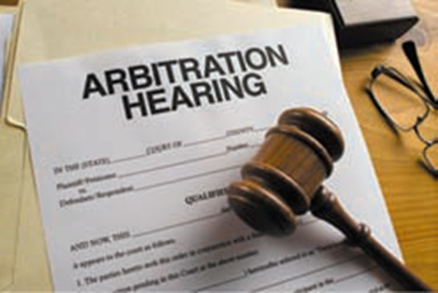
Arbitration (1 of 4)
The most formal ADR method, it uses an arbitrator to hear and decide on the dispute.
Binding or nonbinding
Resembles trial:
  Parties present opening arguments
  Parties ask for specific remedies
  Present evidence, may call and examine witnesses
  However, procedural rules are much less restrictive than in litigation

Slide 44
Arbitration (2 of 4)
Arbitration Decision
  Award reached can be appealed, but will be set aside only if:
    Arbitrator’s conduct or “bad faith” substantially prejudiced the rights of one of the parties
    Award violates an established public policy
    Arbitrator arbitrated issues parties did not agree to arbitrate
Notes:
An arbitrator’s decision is called an award, and is the final word on the matter. There are limited situations where a court will set aside an arbitrator’s award.

Slide 45
Arbitration (3 of 4)
Arbitration clauses: several disputes arise under an arbitration contract clause
Arbitration statutes: state statutes based on Uniform Arbitration Act
Case Example 4.13: In re Cox Enterprises, Inc. Set-top Cable Television Box Antitrust Litigation (2016)
Notes:
Cox Enterprises case: cable subscribers sued Cox Communications, Inc. claiming that Cox had violated antitrust law by tying premium cable service to the rental of set-top boxes. Cox filed a motion to compel arbitration based on an agreement it had sent subscribers. The Circuit Court of Appeals affirmed the district court’s decision in favor of Cox’s motion to compel arbitration based on the Federal Arbitration Act.

Slide 46
Arbitration (4 of 4)
Mandatory Arbitration in Employment Context
  U.S. Supreme Court has held that mandatory arbitration clauses in employment contracts are generally enforceable
Case Example 4.14: Gilmer v. Interstate/Johnson Lane Corp.
Notes:
The issue of arbitrability: when one party files a lawsuit to compel arbitration, the court must decide whether the matter can be resolved through arbitration.
Mandatory arbitration in the employment context: the U.S. Supreme Court has held that mandatory arbitration clauses in employment contracts are generally enforceable.
Classic Case Example 4.14 Gilmer v. Interstate/Johnson Lane Corp. (1991): landmark decision where Supreme Court held a claim brought under a federal statute prohibiting age discrimination could be subject to arbitration. The Court concluded that the employee had waived his right to sue when he agreed, as part of a required registration application to be a securities representative with NY Stock Exchange, to arbitrate “any dispute, claim, or controversy” relating to his employment. Since Gilmer, some courts have refused to enforce one-sided arbitration clauses. Nevertheless, the policy favoring enforcement of mandatory arbitration agreements remains strong.

Slide 47
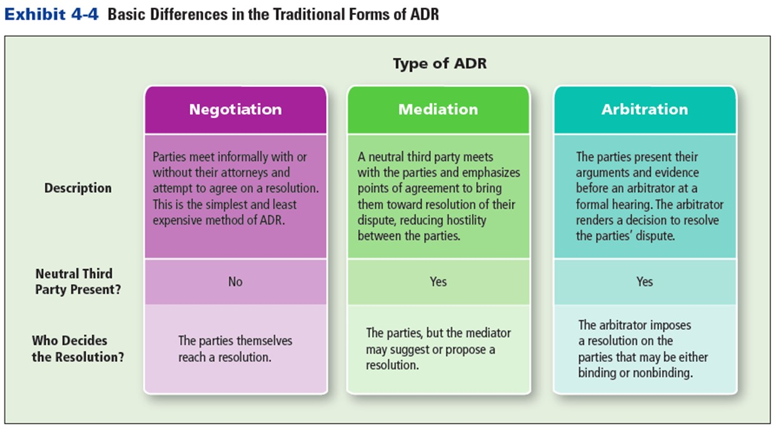
Basic Differences in the Traditional Forms of ADR
Exhibit 4-4 Basic Differences in the Traditional Forms of ADR

Slide 48
Other Types of ADR
Early neutral case evaluation
Mini-trial
Summary jury trial (SJT)
Notes:
Early neutral case evaluation: parties select a neutral third party (generally an expert in the subject matter of the dispute), and then explain their respective positions to that person. The case evaluator assesses the strengths and weaknesses of each party’s claims.
Mini-trial: each party’s attorney briefly argues the party’s case before the other party, and a panel of representatives from each side have the authority to settle the dispute. Typically, a neutral third party (usually an expert in the area being disputed) acts as an adviser. If the parties fail to reach an agreement, the adviser renders an opinion as to how a court would likely decide the issue.
Summary jury trials (SJTs): parties present their arguments and evidence. A jury renders a non-binding verdict, but it acts as a guide to both sides in reaching an agreement during the mandatory negotiations that immediately follow the trial.

Slide 49
Providers of ADR Services
Arbitration Providers
  American Arbitration Association (AAA) (nonprofit association)
  ADR Firms (for-profit companies)
    Retired judges often conduct arbitration hearings, or help parties settle dispute

Slide 50
Online Dispute Resolution (ODR)
ODR
  Growing method for resolving disputes in online forums
  Often used to resolve Internet-based disputes
  Often apply general, universal legal principles rather than law of any specific jurisdiction
  Suited well for resolving small- to medium-sized business’ liability claims
Case Example 4.15: New York City and Cybersettle.com
Notes:
Case Example 4.15: New York City has used Cybersettle.com to resolve auto accident, sidewalk, and other personal-injury claims against the city.

Slide 51
Summary
Now that the lesson has ended, you have learned:
Differentiate between types of jurisdiction in state and federal courts.
Define venue and standing.
Define arbitration, negotiation, and mediation.
Describe the benefits of alternative dispute resolution.
Identify the types of claims are best settled by alternative dispute resolution.
Identify when a mandatory arbitration clause may have you struck down.

