Slide 1

5
C H A P T E R
Accounting Systems
Accounting
27e
Warren
Reeve
Duchac
human/iStock/360/Getty Images

Slide 2
Basic Accounting Systems (slide 1 of 2)
An accounting system is the methods and procedures for collecting, classifying, summarizing, and reporting a business’s financial and operating information.
As a business grows and changes, its accounting system also changes in the following three-step process.
Step 1: Analyze user information needs.
Step 2: Design the system to meet the user needs.
Step 3: Implement the system.

Slide 3
Basic Accounting Systems (slide 2 of 2)
Internal controls are the policies and procedures that protect assets from misuse, ensure that business information is accurate, and ensure that laws and regulations are being followed.
Processing methods are the means by which the accounting system collects, summarizes, and reports accounting information. These methods may be either manual or computerized.

Slide 4
Manual Accounting Systems
Understanding a manual accounting system is useful in identifying relationships between accounting data and reports.
When a business has a large number of similar transactions, using an all-purpose (two-column) journal is inefficient and impractical. In such cases, subsidiary ledgers and special journals are useful.

Slide 5
Subsidiary Ledgers (slide 1 of 2)
A large number of individual accounts with a common characteristic can be grouped together in a separate ledger called a subsidiary ledger.
The primary ledger, which contains all of the balance sheet and income statement accounts, is called the general ledger.
Each subsidiary ledger is represented in the general ledger by a summarizing account, called a controlling account.
Subsidiary ledgers provide detail of individual accounts that are summarized in a controlling account in the general ledger.

Slide 6
Subsidiary Ledgers (slide 2 of 2)
Two of the most common subsidiary ledgers are the accounts receivable subsidiary ledger and the accounts payable subsidiary ledger.
The accounts receivable subsidiary ledger, or customers ledger, lists the individual customer accounts in alphabetical order. The controlling account in the general ledger that summarizes the debits and credits to the individual customer accounts is Accounts Receivable.
The accounts payable subsidiary ledger, or creditors ledger, lists individual creditor accounts in alphabetical order. The related controlling account in the general ledger is Accounts Payable.

Slide 7
Special Journals (slide 1 of 2)
One method of processing transactions more efficiently in a manual system is to use special journals.
Special journals are designed to be used for recording a single kind of transaction that occurs frequently.
Special journals summarize common transactions that are used frequently.
The all-purpose two-column journal, called the general journal or simply the journal, can be used for entries that do not fit into any of the special journals.

Slide 8
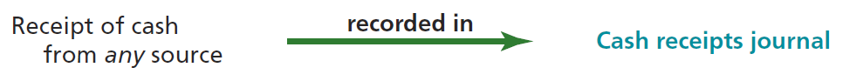
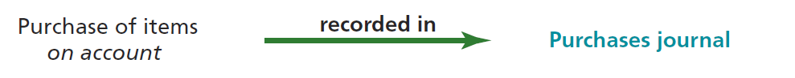
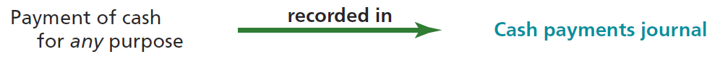
Special Journals (slide 2 of 2)

Slide 9
Revenue Journal
The revenue journal is used for recording fees earned on account.
Revenues are normally recorded in the revenue journal when the company sends a bill, or invoice, to the customer.
Each invoice is normally numbered in sequence for future reference.

Slide 10
Cash Receipts Journal
All transactions that involve the receipt of cash are recorded in a cash receipts journal.
Every entry recorded in the cash receipts journal will involve a debit to the Cash Dr. column.
The types of cash receipt transactions and their frequency determine the titles of the other columns. For example, if a business frequently receives cash from customers on account, an Accounts Receivable Cr. column is set up.
The receipt of cash for infrequent transactions will be listed individually in the Other Accounts Cr. column.

Slide 11
Accounts Receivable Control Account and Subsidiary Ledger
After all posting has been completed for the month, the total of the accounts in the accounts receivable subsidiary ledger should equal the balance of the accounts receivable controlling account in the general ledger.
The balance of the accounts receivable controlling account equals the sum of the customer account balances.

Slide 12
Purchases Journal
The purchases journal is designed for recording all purchases on account.
Every entry recorded in the purchases journal will involve a credit to the Accounts Payable Cr. column.
The items most often purchased on account will determine the titles of the other columns. For example, if the purchase of supplies on account occurs frequently, then a Supplies Dr. column is set up.
The items purchased on account infrequently will be listed individually in the Other Accounts Dr. column.

Slide 13
Cash Payments Journal
All transactions that involve the payment of cash are recorded in the cash payments journal.
Every entry recorded in the cash payments journal will involve a credit to the Cash Cr. column.
The kinds of transactions in which cash is paid and how often they occur determine the titles of the other columns. For example, if the payment of cash to creditors on account occurs frequently, then a Accounts Payable Dr. column is set up.
The payment of cash for infrequent transactions will be listed individually in the Other Accounts Dr. column.

Slide 14
Accounts Payable Control Account and Subsidiary Ledger
After all posting has been completed for the month, the total of the accounts in the accounts payable subsidiary ledger should equal the balance of the accounts payable controlling account in the general ledger.
The balance of the accounts payable controlling account equals the sum of the creditor account balances.

Slide 15
Computerized Accounting Systems
Computerized accounting systems have the following three main advantages over manual systems:
Computerized systems simplify the record-keeping process by recording transactions in electronic journals or forms and, at the same time, posting them electronically to general and subsidiary ledger accounts.
Computerized systems are generally more accurate than manual systems.
Computerized systems provide management with current account balance information to support decision making, since account balances are posted as the transactions occur.

Slide 16
E-Commerce
Using the Internet to perform business transactions is termed e-commerce.
When transactions are between a company and a consumer, it is termed B2C (business-to-consumer) e-commerce.
When transactions are between two companies, it is termed B2B (business-to-business) e-commerce.
Three additional areas where the Internet is being used for business purposes are:
Supply chain management (SCM)
Customer relationship management (CRM)
Product life-cycle management (PLM)

Slide 17
Financial Analysis and Interpretation: Segment Analysis
One way to report revenue is by different segments. Businesses may be segmented by region, by product or service, or by type of customer.
The segment information can be used to perform horizontal analysis using the prior year as the base year.
In addition, vertical analysis can be performed on the segment disclosures.

