Slide 1
Business Etiquette
Etiquette for dress, greetings, business cards, meals, thank you notes, social settings and international business.

Slide 2
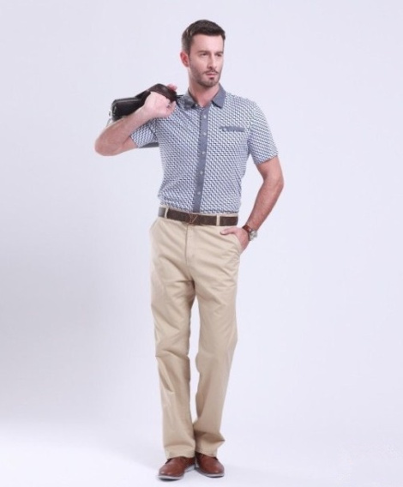
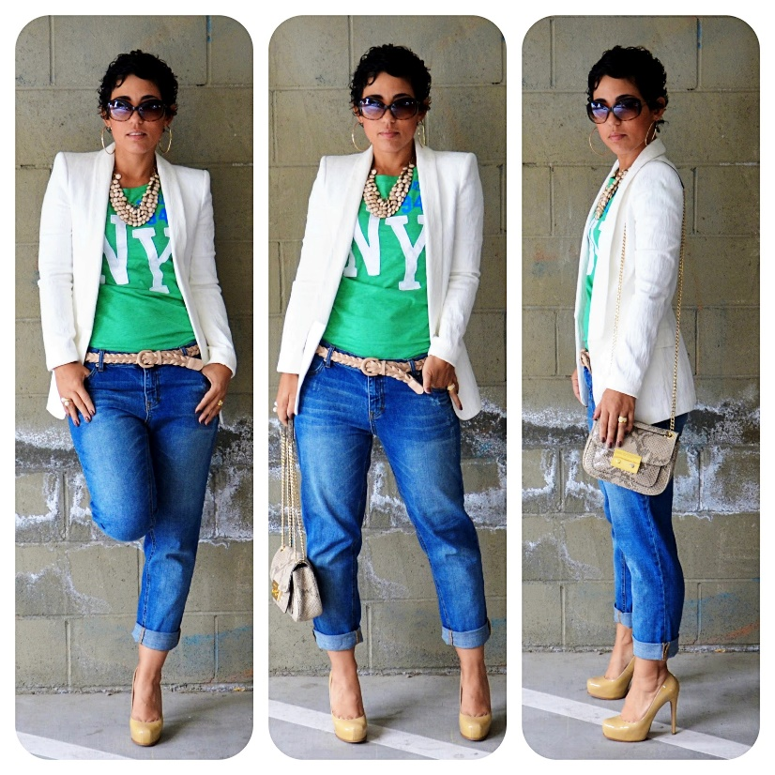
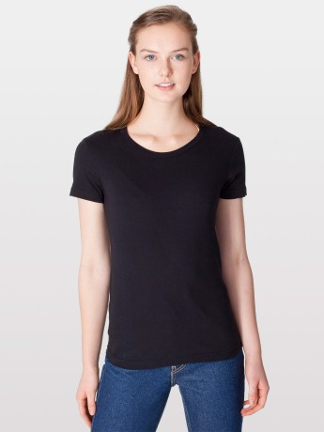
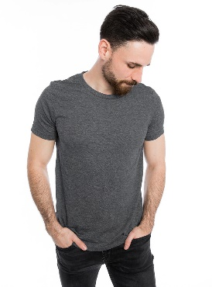
Dressing for Work
Notes:
Times have changed. Part of business etiquette is knowing your environment.
Today business attire can range from the traditional to the causal.
We may see women with shaved heads, men with full beards, exposed tattoos, all in professional settings.
The key is knowing the culture of your business and your clients.
The beginning of this presentation discusses different expectations for business dress. Again, know your environment so you can decide which “rules” apply to you.

Slide 3
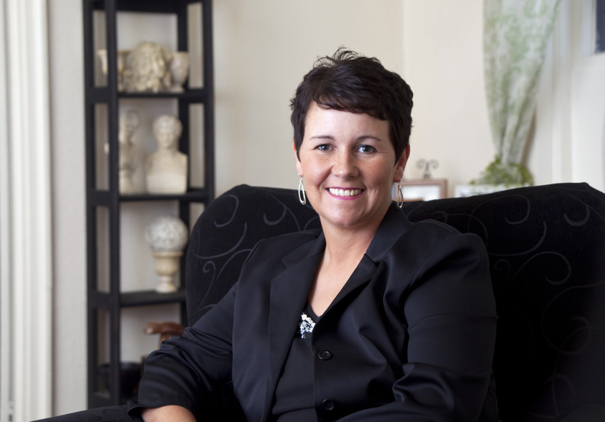
How to Dress for Success
Professional dress
This is the most conservative type of business attire and expected in accounting, finance and other conservative industries.
Notes:
Women will be dressed in a business suit, pants suit or a dress with a jacket. Colors should be cool or dark, in solid or simple patterns. Skirts and dresses should not be above the knee and should be worn with neutral colored stockings. No low cut tops and jewelry should be kept to a minimum. Makeup should be natural looking, nails groomed, hair away from your face and perfume used very sparingly.
Men should wear a suit, or a blazer and dress slacks with a tie. Colors should be dark and it should fit comfortably Ties should be color coordinated with the suit and should be a simple pattern. Shoes should be dark and well-polished Jewelry should be a watch and wedding ring. Belts should complement your shoes and have a simple buckle. Men should be clean shaven, with well trimmed hair and nails.

Slide 4
Business Casual
This is a more relaxed version of “professional dress”
Notes:
A relaxed version of professional dress for women would be a shirt with a collar, a sweater, khakis or dress slacks, knee length skirt or longer.
For men it can be a polo shirt or shirt with a collar, a sweater, khakis or dress pants and dress shoes. No tie is necessary in this style.

Slide 5
Campus Casual
Notes:
This would be clothing that you would wear around home or to school.
Jeans would be in this classification and depending on your work place they may be allowed. If meeting customers or clients, they should not be worn.
Tee shirts, sneakers and flip flops would also fit into this classification.

Slide 6
Tips for Take Away
When in doubt opt for professional dress rather than casual attire
Be aware of cultural dress codes if attending international events or traveling in foreign countries
Your appearance sends a message about you
First impressions count
Notes:
Show respect, show interest, and listen
You are a representative of your employer and what you wear is a reflection on them
Fit is very important, iron those shirts and skirts

Slide 7
Business Etiquette Greetings
These can range from:
Personal meetings
Phone calls
Letters
Emails
Proper etiquette should be expected in all forms.
Notes:
In personal meetings let the meeting arranger take control and be in charge
State your full name
Give a firm hand shake
Look directly at the person, smile, show interest and listen fully
Do not fidget, play with clothing or shuffle your feet
Respond promptly when asked a question
Business cards will be addressed in a later slide

Slide 8
Business Etiquette Greetings
Personal Meetings
Let the meeting arranger take control
State your full name and give a firm handshake
Look directly at the other person. Smile, show interest and listen fully
Do not fidget, play with clothing or shuffle your feet
Respond promptly when asked a question

Slide 9
Business Etiquette Greetings
Phone calls
Always greet the caller, state your name and the company name
Ask what they are looking for “how may I help you”
Take good notes and add their name and company to the note
Confirm the information requested and your plan of action for follow up with the customer
Return all voice mails as soon as possible or within 8 hours

Slide 10
Business Etiquette Greetings
Letters
“Dear Mr.” or Mrs. or Ms. is still a proper greeting for a letter
Use titles for the person you are addressing - Dean, Professor, Doctor
Depending upon your knowledge and familiarity of the person, you may be less formal and use their first name
Keep content to the point
Use “Sincerely” for the close
Use proper grammar and punctuation
Spell check
Always double check before you send

Slide 11
Business Etiquette Greetings
Emails
Less formal than a letter but…
You must still make a good impression
Always include a proper greeting
Spell check
Grammar
Be cautious using ALL CAPITAL LETTERS for complete words or sentences… can create a ‘tone’ of yelling
Notes:
Remember perception IS reality; be extremely cautious about using all CAPITAL LETTERS in your e-mails; it can create a tone that can be perceived as expressing anger, yelling, or aggression.
Be aware of your signature and what your tags and background items might be saying about you
When several responses on the same email become excessive delete the unnecessary and be aware of whom you are responding to or start a new one with only the person necessary
Do all of the people on the email really need to see 15 emails

Slide 12
Business Card Exchange Etiquette
When is it appropriate?
How to present
Hand the card so the receiver can read it
Assure your card is in pristine condition
What to do now?
Notes:
It is appropriate to hand out business cards at either the beginning or end of a meeting.
Never hand out your cards like you are dealing a deck of cards or playing poker.
Hand with either right hand or both hands
Look at the person you are presenting the card to and smile.
When receiving a business card accept it in the same manner you present with the right hand or both hands.
Take a few moments to study the card and clarify any information as needed. Once you return to your office, enter the information into your database
Business cards should be kept in a separate case and you should never slide it in a back pocket and sit on it.
Asking for a second card is a faux pas.

Slide 13
International Business Card Exchange
Internationally business cards are a recognized means of presenting yourself in a professional manner
Rules for card presentation vary in cultures and can be shown as a powerful tool or as an insult to the receiver if done incorrectly
If possible have your card printed on one side in the language of the country you are visiting
Notes:
Internationally presenting your card with your left hand is a serious insult in some countries.
What you do in one country might not work for another.
Business cards in some cultures are of great importance, and viewed as a representation of the owner and thereby demands that it be treated with respect and honor.
Tips for different countries (Note: feel free to use one or all of these examples, as appropriate for your audience)
China have one side printed in Chinese with gold ink
Ensure the translation is in the appropriate dialect
It should include your title
If you company is the oldest or largest in your country that should be noted on the card
Hold the card in both hands when presenting
Never write on the card unless instructed to
India
Include your university degree or an honor
Always use your right hand to present the card
English is widely spoken within the business community
Japan
Business cards are exchanged with great ceremony
Must be in pristine condition
Treat the business card you receive as you would treat the person you are meeting
Include your title, Japanese place emphasis on status and hierarchy
Place the cards on the table in front of you in order at the table and after the meeting put them in a card case

Slide 14
Business Etiquette – Thank You Notes
When is it appropriate?
Four components of a Thank You note
“Thank you” for the time shared, assistance, opportunity, etc.
Express further detailed review and your appreciation for the information given
Share specific reasons why this is important
Closing – “Thank you again” or pleasant remark
Notes:
(Ask the audience) – When do you think it is appropriate to send a “Thank You” note?
Responses – after a job interview/after meeting with someone to obtain information from them/any time someone is kind enough to give time out of their busy day to do something that is helpful to you
The type of Thank You note may depend on the relationship you have with the person, and the particular situation.
Written thank you notes should be sent as soon as possible after the meeting. Depending on the situation, an email thank you may be appropriate. For example, if it is a job interview, and the interviewer tells you they plan to make a decision quickly, it would be a good idea to send an email Thank you, and perhaps follow up with a written Thank You note.
Remember that it is always appropriate to send a Thank you note, and this small act could set you apart (and above) the competition.
To show appreciation for their time and assistance.

Slide 15
Business Etiquette for Dining
The Basics:
Arrive early
Personal belongs under the table
Place napkin in your lap
Elbows off the table
Turn off cell phones and put them away
Wait for all parties’ food to arrive before eating
Do not move any of the utensils (even if you are left handed)
Notes:
When you think of etiquette guidelines as related to dining, most of us probably have a lot of things that pop into your head.
There are a few general guidelines everyone should follow during a business dinner. Most of them, as you see, are strictly Common Sense, and you have probably heard them from the adults in your life for many years. (be on time, napkin on your lap, elbows off the table, etc.) but there are several other tips that are good to know.
These days it is very difficult to avoid the temptation of placing our cell phones on the table, or checking for texts/emails during dinner. Try to avoid doing this if at all possible.

Slide 16
Business Etiquette for Dining
Avoid ordering the most expensive item
Alcohol – follow the lead of the host
Cut one bite at a time
Place utensils on plate, not the table
Use napkin frequently
Take small bites and pace yourself to finish with everyone else
Notes:
There are numerous other ones you may be familiar with, such as:
The Salt and Pepper are “married.” If someone asks you to pass one, you should always pass both.
Break your bread into pieces and butter each separately
Gently stir your soup to cool and spoon away from yourself
Start at the outside of the place setting and work in towards the plate with each course
Pass food from the left to the right
I’m sure there are others you have heard of over the years. Do any of you have any others you would like to share?
One of the most important things to remember is that we now live in a less formal world, and it would always be more rude to call out another person for missing one of the etiquette “cues” than to “let it pass.”

Slide 17
Business Etiquette for International
Considerations:
Culture
“You only get one chance to make a first impression”
Personal space – how close is too close?
Proper dress for each culture
Greeting - bowing or handshake
Notes:
When interacting with colleagues, associates, customers, etc. in another country, or from another country, you must be aware that different cultures may have different customs or practices. In order to be prepared for these differences, it is imperative that you study their culture in advance, in order to be aware of what is proper and accepted.
Always remember that you only get one chance to make a first impression, and you want to make it a good one.
For example: (Note: feel free to use one example, or all, as you feel applicable)
In Japan, politeness is paramount. You should speak English slowly, making sure that what you are saying is being understood. You should dress neatly and conservatively., and be prepared for crowds.
In Taiwan, things move quickly. The company is always right, and you should not question authority. Expect to negotiate.
Hong Kong’s culture is Westernized, but still Eastern. They are one of the easiest Asian countries to work with but they do not like to take risks. They are safety conscious.
The Chinese generally expect haggling (over everything, nothing is final). Time is not of the essence, and they have a hierarchical work style.
All Asians are thought to place a great deal of importance on relationships. Building of long lasting relationships is tantamount for business success within these countries.
The concept of “saving face” is inherent in this region. Embarrassment or loss of face is not easily forgotten.
When dealing with Russia, expect lots of paperwork. Laws are understood primarily to circumvent them. This is likely a result of lingering social/psychic effects of Soviet regime. In recent years, there seems to be a wide divide between traditional Russia and emerging Russia
In Brazil, Portuguese is the official language, but Spanish and Italian are frequently spoken.
Mexico is a federal republic. Spanish is the official language. Only way to conduct business successfully is to know someone, to be part of the business family. Trust is critical to do business in Mexico. Time and traditions are very important in their culture. Time is not of the essence
South Africa has six major ethnic groups. Eleven official languages are spoken.
Even within the United States, there are cultural differences you should be aware of when dealing with people from specific areas. People on the East coast are considered more conservative and formal in dress and manners. Whereas on the West coast, people may seem less formal and more relaxed.

Slide 18
Business Etiquette - Conclusion
Final thoughts
Questions / Discussion Points??
Thank you!!

