Slide 1
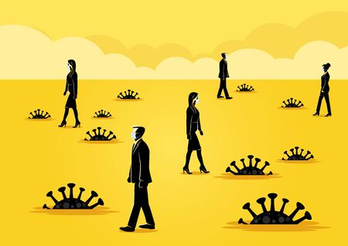
Business Risks With Utilization of Artificial Intelligence in the Workplace
By: Jeremy L. Kahn
Notes:
Hello, and welcome to this presentation on the legal implications of using ChatGPT in your business. My name is Jeremy Kahn, and I am a Principal at Berman Fink Van Horn. In this presentation, I will discuss the benefits and risks of using ChatGPT, and the legal considerations you should keep in mind when using this technology.

Slide 2
Agenda
Benefits of Using Generative AI
Risks of Using Generative AI
Legal Considerations When Using Generative AI
Ways to Protect Your Business While Using Generative AI in the Workplace
Conclusion and Q&A

Slide 3
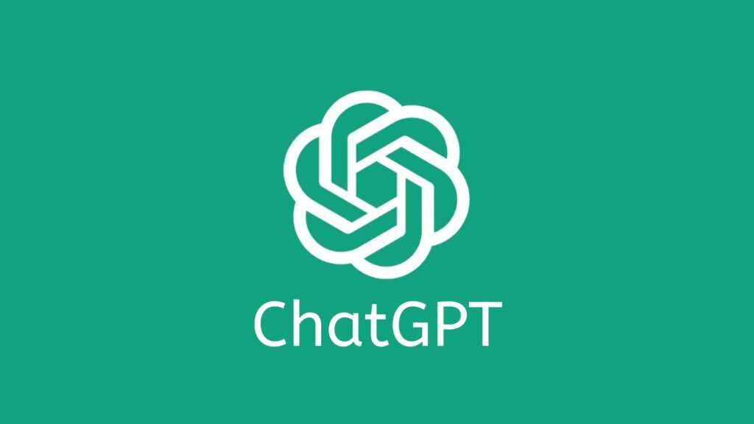
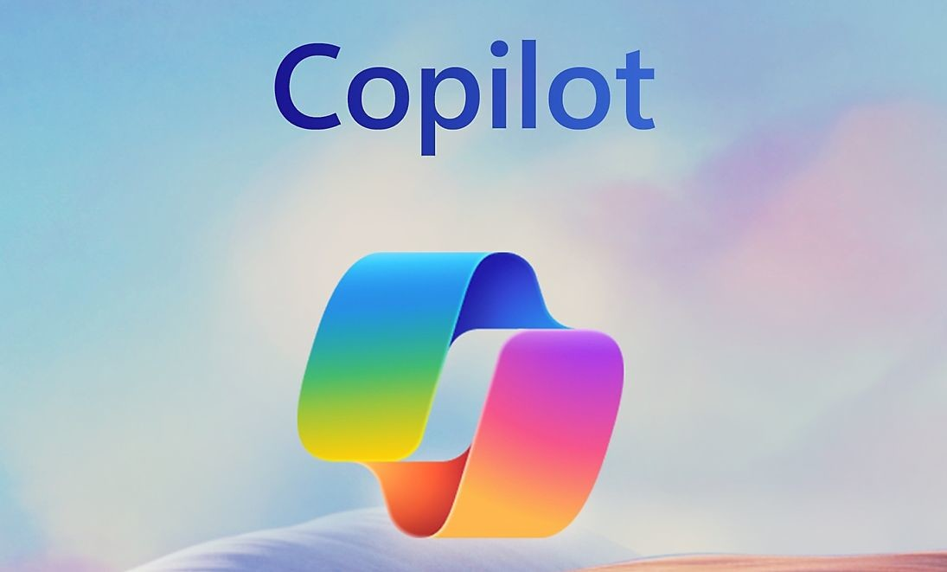
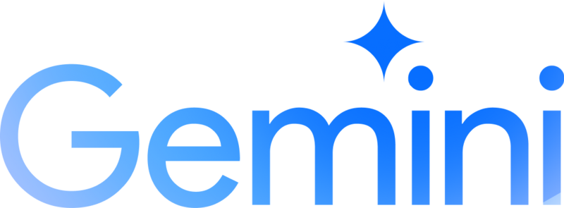
The benefits of Generative AI
What is Generative AI?
Generative AI is artificial intelligence that can generate text, images, or other data using generative models usually in response to user’s prompts.
“GPT” refers to generative pretrained transformer. GPT models are artificial neural networks that use deep learning to generate human-like text (or images, music, speech, code, etc.).
Trained on a large body of text data (large language model) and then fine-tuned.
Notes:
The software generates new answers on the fly. And each time you run the app, a different answer will be spit out. Each answer is unique. And systems like ChatGPT are constantly evolving. They learn as more people use the system, and the neural network grows. In others words, they store and remembers data inputted into it and then uses, or may even reproduce, that information in responses to queries from other users.

Slide 4
The benefits of Generative AI
Notes:
The software generates new answers on the fly. And each time you run the app, a different answer will be spit out. Each answer is unique. And systems like ChatGPT are constantly evolving. They learn as more people use the system, and the neural network grows. In others words, they store and remembers data inputted into it and then uses, or may even reproduce, that information in responses to queries from other users.

Slide 5
Notes:
You can also ask follow-up questions or provide new information to “train” ChatGPT and revise answers.

Slide 7
The benefits of Generative AI
Numerous Use Cases
Creative Content Generation:
Producing art, music, and literature.
Designing logos, graphics, and illustrations.
Generating realistic images and videos.
Text Generation and Natural Language Processing (NLP):
Writing articles, stories, and scripts.
Crafting personalized emails and responses.
Generating code and technical documentation.
Personalization and Recommendation Systems:
Customizing product recommendations for users.
Tailoring content and advertisements based on preferences.
Generating personalized responses in chatbots and virtual assistants.
Predictive Modeling and Forecasting:
Generating scenarios for financial modeling.
Simulating outcomes for strategic planning.
Predicting trends and patterns in various domains.
Automating Content Creation:
Generating product descriptions and reviews.
Automatically summarizing large documents and texts.
Creating news articles and reports from data.
Improving Accessibility:
Generating alternative text for images and videos.
Converting speech to text and vice versa.
Creating translations and transcriptions in multiple languages.
Notes:
The software generates new answers on the fly. And each time you run the app, a different answer will be spit out. Each answer is unique. And systems like ChatGPT are constantly evolving. They learn as more people use the system, and the neural network grows. In others words, they store and remembers data inputted into it and then uses, or may even reproduce, that information in responses to queries from other users.
Benefits are generally increased efficiency and productivity.

Slide 8
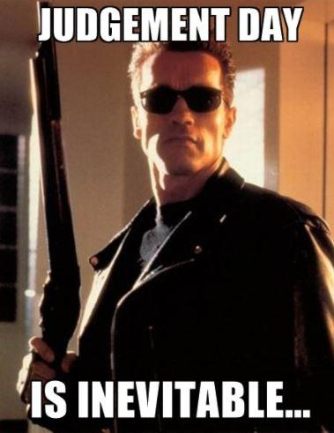
The risks of Generative AI

Slide 9
The risks of Generative AI
What are the risks of ChatGPT?
Privacy concerns
Disclosing confidential information
Reputational damage
Legal liability
Notes:
Privacy concerns: ChatGPT may collect and store personal information about your customers, such as their name and contact information. It is important to comply with applicable privacy laws and ensure that your customers' personal information is stored securely.
Disclosing confidential information: As with privacy concerns, ChatGPT may collect and store information inputted.
Reputational damage: ChatGPT's responses may be perceived as insensitive or offensive, potentially damaging your business's reputation. It is important to regularly review ChatGPT's responses and ensure they align with your business's values and policies. Also, consider whether using ChatGPT is appropriate for the context. It would be embarrassing to be caught plagiarizing. Also, use of ChatGPT could be insensitive or insincere in some circumstances. One extreme example is Vanderbilt using ChatGPT to write an email to students to address the mass-shooting at Michigan State.
Legal liability: ChatGPT's responses can sometimes be inaccurate or inappropriate, which can result in legal liability for your business. It is important to have disclaimers in place that limit your liability, as well as a process for reviewing and correcting inaccurate or inappropriate responses.

Slide 10
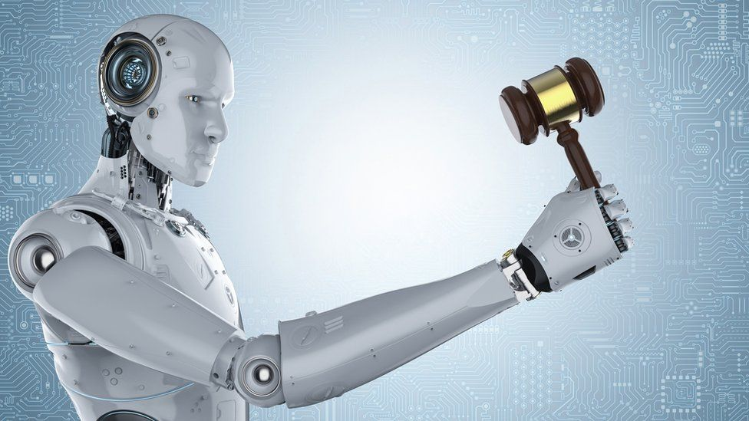
Legal considerations for Generative AI
Privacy laws
Trade secret law
Defamation
Copyright law
Employment discrimination
Liability based on other inaccuracies

Slide 11
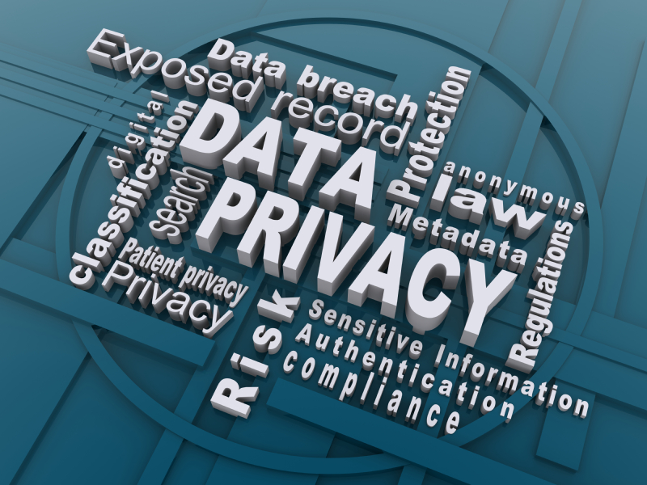
Privacy Laws
HIPAA
Gramm-Leach-Bliley Act
Federal Trade Commission Act
General Data Protection Regulation (GDPR)
EU AI Act
State laws (e.g., California Consumer Privacy Act)
Private contracts
Notes:
HIPAA protects protected health information, or PHI. Those in the medical or mental health care profession in particular could commit a HIPAA violation by disclosing PHI to ChatGPT.
Gramm-Leach applies to financial institutions and protects certain customer information from disclosure.
The Federal Trade Commission Act prohibits “unfair or deceptive acts or practices,” and empowers the FTC to bring enforcement actions against companies that engage in such practices. The FTC has filed such enforcement actions against companies that violate their own privacy policies, which customers rely on.
GDPR mainly applies to companies doing business in Europe, but it can also apply outside Europe. For example, a U.S. company with European customers would be subject to the GDPR. Italy recently temporarily banned ChatGPT pending an investigation into whether it violates privacy regulations. The EU has also proposed new legislation called the European AI Act, which would also restrict the use of AI in certain contexts.
Some states have laws protecting customer information, such as California.
You may be contractually obligated to keep certain information confidential. Disclosure to ChatGPT could be a breach of contract. For example, if you are a consultant using ChatGPT to provide advice to clients, you should make sure not to reveal your client’s confidential information.
Again, ChatGPT trains on the input that is provided to it, so information inputted by one user could be disclosed to another user.
Bottom line: Don’t input any information into ChatGPT that you would not disclose in other contexts.

Slide 12
Trade Secret Law
the term “trade secret” means all forms and types of financial, business, scientific, technical, economic, or engineering information, including patterns, plans, compilations, program devices, formulas, designs, prototypes, methods, techniques, processes, procedures, programs, or codes, whether tangible or intangible, and whether or how stored, compiled, or memorialized physically, electronically, graphically, photographically, or in writing if—
(A) the owner thereof has taken reasonable measures to keep such information secret; and
(B) the information derives independent economic value, actual or potential, from not being generally known to, and not being readily ascertainable through proper means by, another person who can obtain economic value from the disclosure or use of the information;
18 U.S.C. § 1839(3).
Notes:
Even an accidental or inadvertent disclosure can result in a loss of trade-secret protection. A disclosure to ChatGPT could possibly result in a finding that information is not a trade secret. Or at the very least, it could make litigation more expensive by providing a factual defense to a misappropriator.

Slide 13
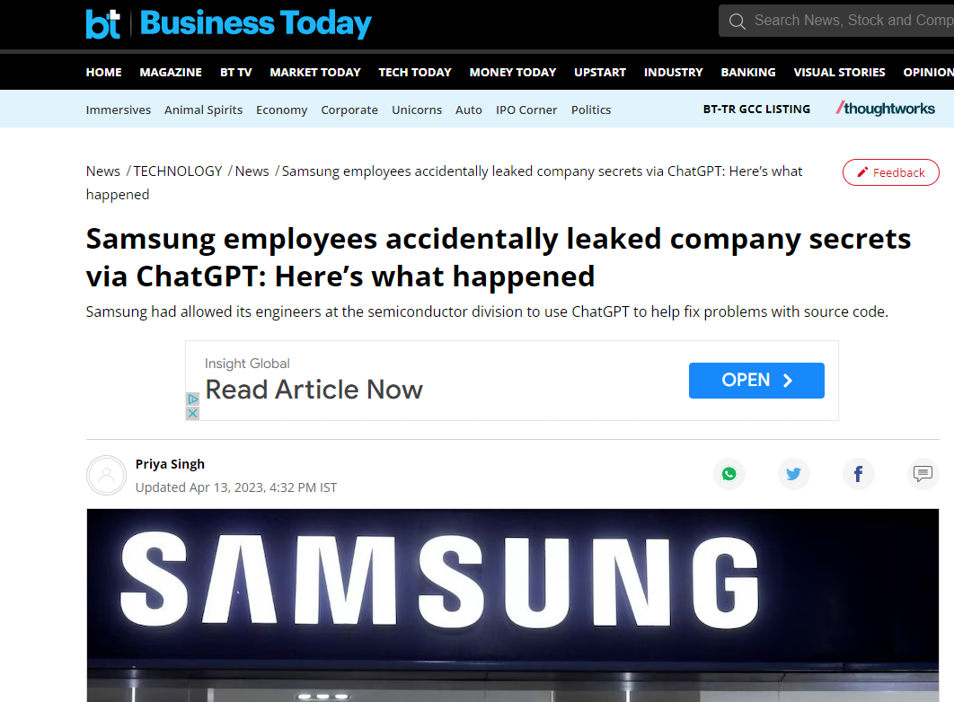
Notes:
Three separate instances of Samsung employees unintentionally leaking sensitive information to ChatGPT. In one instance, an employee pasted confidential source code into the chat to check for errors. Another employee shared code with ChatGPT and "requested code optimization." A third, shared a recording of a meeting to convert into notes for a presentation. That information is now out in the wild for ChatGPT to feed on. Since ChatGPT retains user input data for machine learning to train itself, the workers effectively, and inadvertently, disclosed Samsung confidential information to OpenAI.
Not only would this show if something was disclosed and lost trade-secret protection (i.e., whether a trade secret was an input), it could also raise an issue of whether the purported “owner” of something created with the help of ChatGPT really “owns” the trade secret (i.e., output subject to trade-secret protection?).

Slide 15
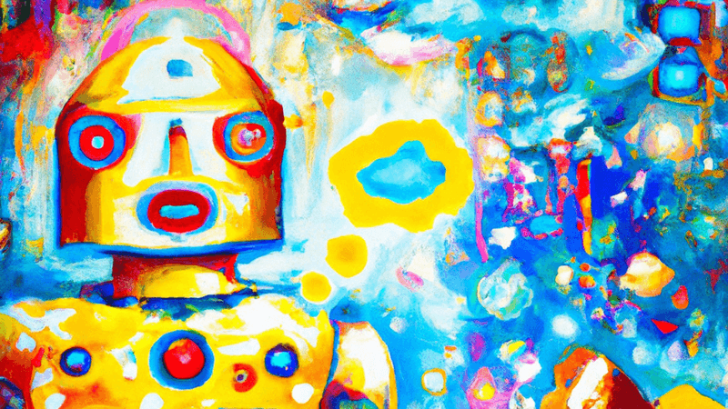
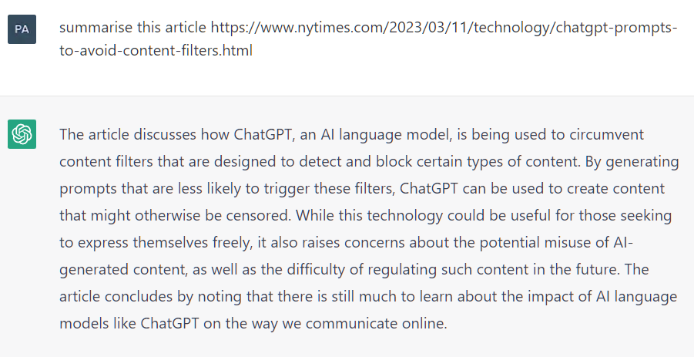
Inaccuracies/Defamation
“ChatGPT sometimes writes plausible-sounding but incorrect or nonsensical answers.” – OpenAI website
“Hallucinations”
Notes:
“Hallucination” in AI refers to the generation of outputs that may sound plausible but are either factually incorrect or unrelated to the given context. These outputs often emerge from the AI model's inherent biases, lack of real-world understanding, or training data limitations. In other words, the AI system "hallucinates" information that it has not been explicitly trained on, leading to unreliable or misleading responses.

Slide 16
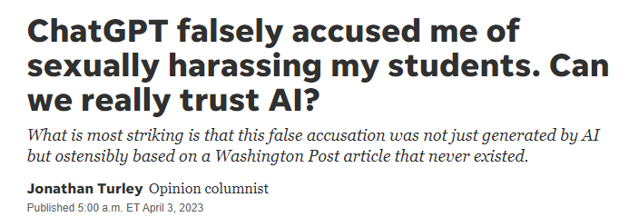
Inaccuracies/ Defamation
Notes:
Volokh made this query of ChatGPT: "Whether sexual harassment by professors has been a problem at American law schools; please include at least five examples, together with quotes from relevant newspaper articles."
The program responded with this as an example: 4. Georgetown University Law Center (2018) Prof. Jonathan Turley was accused of sexual harassment by a former student who claimed he made inappropriate comments during a class trip. Quote: "The complaint alleges that Turley made 'sexually suggestive comments' and 'attempted to touch her in a sexual manner' during a law school-sponsored trip to Alaska." (Washington Post, March 21, 2018).“
CNET admitting to publishing about 75 articles using ChatGPT after multiple inaccuracies were found in the articles.

Slide 17
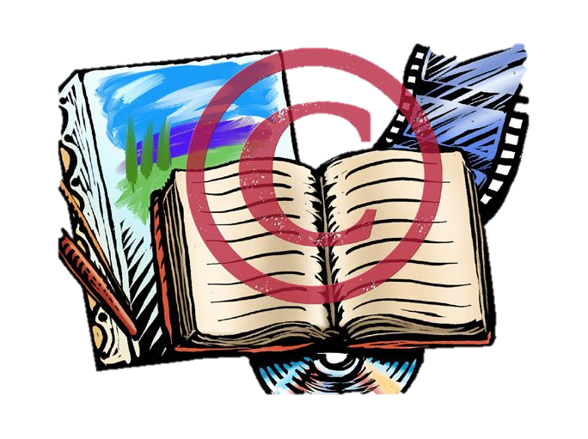
Copyright Law
Infringement issues
Protection issues
Notes:
ChatGPT introduces a host of new legal questions in the area of copyright law that could be a presentation in and of itself. Some of the issues include the following.
Copyright infringement: Since ChatGPT provides responses based on publicly available information, including information that is copyright protected, the output could contain copyrighted material or be very similar to copyrighted material. By then publishing that material, a user could inadvertently be infringing on someone’s copyright and be subject to liability.
Another issue involves making sure your own information is copyright protected. If you ask ChatGPT to write a novel for you, can you copyright it? What if you tell ChatGPT the general storyline, but have ChatGPT write it? What if you input a novel and ask ChatGPT to revise or enhance it? Proof it? In which cases are you the “author” with copyright protection? Under U.S. copyright law, copyright protection does not extend to works created solely by a computer but works in which an individual can demonstrate substantial human involvement may qualify for copyright protection.
Using the example above, you should be careful about what copyrightable content you input into ChatGPT. If you put an original work into ChatGPT, ChatGPT will learn from it and may reproduce parts of it in responses to others, leading to others possibly getting copyright protection for your work before it’s registered.
Talk about “Heart on My Sleeve,” using voices and styles of Drake and The Weeknd (not ChatGPT, but other regenerative AI). Universal Music Group, the music label that represents Drake and The Weeknd, sent take down letters to streaming platforms, like Spotify, that were streaming the song. (Is it substantially similar to something they have done? Does it create liability for false light or improper use of likeness?

Slide 18
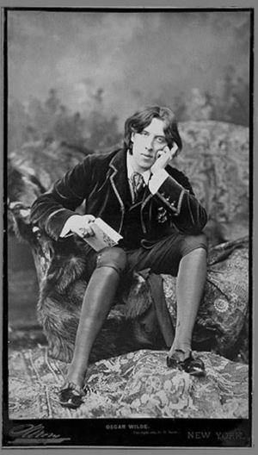
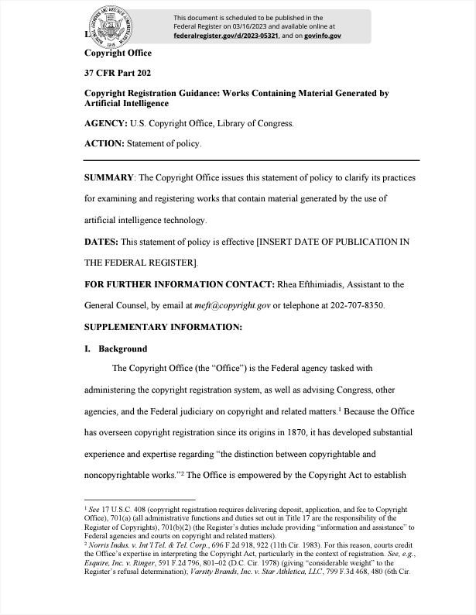
Copyright Law
Burrow-Giles Lithographic Company v. Sarony, 111 U.S. 53 (1884)
Notes:
Like other areas of law, copyright law always has to adapt to new technology that assists in the creation of works. Back in 1884, the Supreme Court had to decide whether a photograph, which is created by a machine – a camera, is copyrightable. Photographer Sarony sued a lithographer for making copies of this photo of Oscar Wilde. Supreme Court ruled there is sufficient human creativity involved in making a photo.
New guidance from Copyright Office:
“If a work’s traditional elements of authorship were produced by a machine, the work lacks human authorship and the Office will not register it. For example, when an AI technology receives solely a prompt from a human and produces complex written, visual, or musical works in response, the “traditional elements of authorship” are determined and executed by the technology—not the human user. Based on the Office’s understanding of the generative AI technologies currently available, users do not exercise ultimate creative control over how such systems interpret prompts and generate material. Instead, these prompts function more like instructions to a commissioned artist—they identify what the prompter wishes to have depicted, but the machine determines how those instructions are implemented in its output. For example, if a user instructs a text-generating technology to “write a poem about copyright law in the style of William Shakespeare,” she can expect the system to generate text that is recognizable as a poem, mentions copyright, and resembles Shakespeare’s style. But the technology will decide the rhyming pattern, the words in each line, and the structure of the text. When an AI technology determines the expressive elements of its output, the generated material is not the product of human authorship. As a result, that material is not protected by copyright and must be disclaimed in a registration application.
In other cases, however, a work containing AI-generated material will also contain sufficient human authorship to support a copyright claim. For example, a human may select or arrange AI-generated material in a sufficiently creative way that “the resulting work as a whole constitutes an original work of authorship.” Or an artist may modify material originally generated by AI technology to such a degree that the modifications meet the standard for copyright protection. In these cases, copyright will only protect the human-authored aspects of the work, which are “independent of” and do “not affect” the copyright status of the AI-generated material itself.
This policy does not mean that technological tools cannot be part of the creative process. Authors have long used such tools to create their works or to recast, transform, or adapt their expressive authorship. For example, a visual artist who uses Adobe Photoshop to edit an image remains the author of the modified image, and a musical artist may use effects such as guitar pedals when creating a sound recording. In each case, what matters is the extent to which the human had creative control over the work’s expression and “actually formed” the traditional elements of authorship.”

Slide 19
Copyright Law
“You may not . . . (v) represent that output from the Services was human-generated when it is not . . . .”
Open AI Terms of Service § 2(c).
Notes:
Consistent with Copyright Office application requirements, terms of use state that you must disclose inclusion of AI-generated content and identify the human author’s contributions to the work.

Slide 20
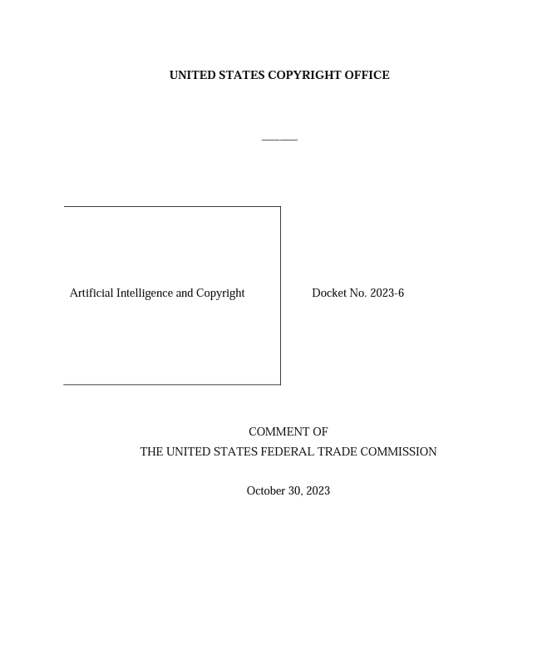
Copyright Law
“Conduct that may violate the copyright laws––such as training an AI tool on protected expression without the creator’s consent or selling output generated from such an AI tool, including by mimicking the creator’s writing style, vocal or instrumental performance, or likeness—may also constitute an unfair method of competition or an unfair or deceptive practice, especially when the copyright violation deceives consumers, exploits a creator’s reputation or diminishes the value of her existing or future works, reveals private information, or otherwise causes substantial injury to consumers. In addition, conduct that may be consistent with the copyright laws nevertheless may violate Section 5.”

Slide 21
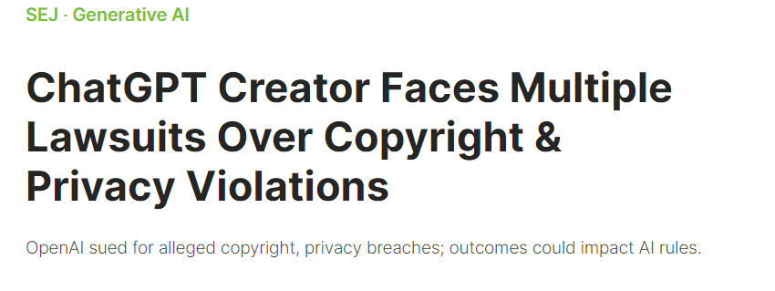
Copyright Law

Slide 22
Copyright Law

Slide 23
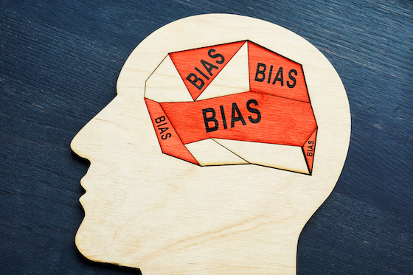
Biases: Employment Discrimination
Notes:
ChatGPT may be helpful in making employment decisions. It could evaluate resumes or answer questions about potential candidate’s experience. ChatGPT responses may be biased, either by the wording of a prompt or information it uses to generate a response. Its answers will only reflect the diversity of its underlying data. Organizations must ensure that the AI systems are not making decisions that are discriminatory or biased and must be able to demonstrate how decisions were made if necessary.
Some state and local laws that require notice of AI use in certain employment decisions and/or audits before using it in certain employment contexts. For example, New York City’s Local Law Int. No. 144, which went into effect on January 1, 2023, prohibits an employer or employment agency from using an “automated employment decision tool” to screen a candidate or employee for an employment decision unless the tool underwent a bias audit and the employer made a summary of such results publicly available on its website prior to using the tool. Local Law Int. No. 144 also implements notice requirements and candidate opt-out requirements with which employers must comply, and even imposes civil penalties of $500 to $1,500 for each violation.

Slide 24
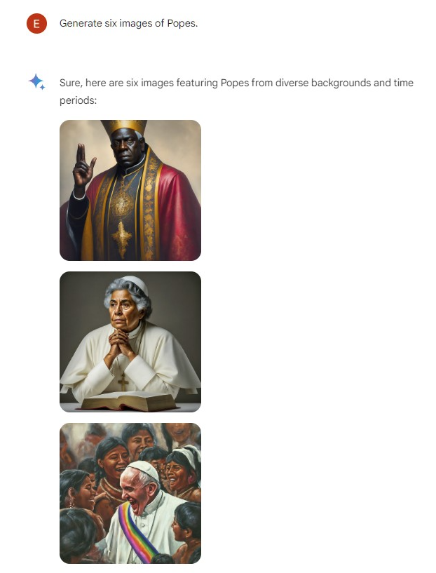
Other Biases

Slide 25
Other Liability Based on Inaccuracies
Improper or invalid policies, contracts, or other legal documents
Misrepresentations to customers
Bad advice to clients
Notes:
Policy that does not actually follow law can lead to liability.
Misrepresentations can lead to liability for deceptive business practices.
Depending on your type of business, providing advice or recommendations to clients or customers that is inaccurate can lead to liability for negligent misrepresentations.

Slide 26
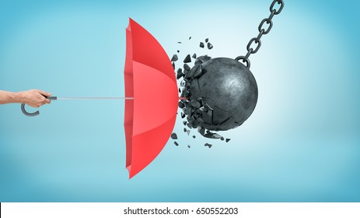
Protecting your business when using Generative AI
Create new policies and update existing policies
Train employees
Security
Obtain consent
Disclosures/Disclaimers
Review content
Notes:
Update policies regarding data disclosure. Policies should clearly communicate to employees what are permitted and prohibited uses of ChatGPT (i.e., acceptable use policy). Consider whether you want to ban ChatGPT or limit its use. You may also want to incorporate ChatGPT into existing policies, such as your HIPAA policy. Review policies of vendors and subcontractors as well, and consider imposing requirements on them.
Also consider whether your document retention policy should address ChatGPT history.
We at BFV would be at happy to review existing policies or help you draft policies appropriate for your business.
Training. Train your employees on the benefits and risks of ChatGPT, and on appropriate and inappropriate uses.
Security. You may want to have your IT impose security limitations, such as limiting which employees are able to access ChatGPT on work devices or limiting the size of data that can be inputted into ChatGPT. In the case of Samsung, it limited its ChatGPT upload capacity to 1024 bytes per person.
Consent. If you are going to input potentially sensitive information into ChatGPT, such as customer information, make sure to obtain consent to collect and use customer’s information to the extent allowable under applicable privacy laws, and provide an opt-out of data collection where appropriate.
Disclosures/Disclaimers. Add disclaimers to representations, especially those generated by ChatGPT, to inform others that information may be inaccurate. Also clarify that the information provided is for general informational purposes only and not legal, medical, or professional advice. Also disclose to clients if ChatGPT is being used to create content or other deliverables for them. Not doing so may be misleading or deceptive, or at least raise ethical or reputational issues.
Review. Don’t just rely on content generated by ChatGPT. Use it to assist you as a starting point, not for the end result. Make sure to review all content for accuracy, nondisclosure of confidential information, and appropriateness in connection with your company’s values and goals. You should regularly review and moderate its responses. You can also set guidelines for responses and train ChatGPT on your business's values and policies.
Last, but not least, you can hire us to help.

Slide 27
Protecting your business when using Generative AI
Who?
Who at your business is (and is not) permitted to use generative AI for work?
What?
What type of information may (and may not) be inputted into a generative AI system?
When?
When is it appropriate (or inappropriate) to use generative AI?
Where?
Where, or on what devices, may generative AI be used?
Why?
For what purposes may generative AI be used?
How?
How is generative AI being used? (Hint: It should always be as an aid and ethically, and never as a substitute for human thought and judgment.)
Considerations for an Effective AI Policy

Slide 28
Q&A
Jeremy L. Kahn
jkahn@bfvlaw.com
https://www.bfvlaw.com/practice-area/artificial-intelligence/
Notes:
Appropriately, I’ll disclose that this conclusion was written by ChatGPT:
In conclusion, ChatGPT can be a valuable tool for improving productivity, efficiency, and customer service in your business. However, it is important to be aware of the potential risks and legal considerations when using this technology. By implementing appropriate measures, such as complying with privacy laws, limiting liability, and moderating content, you can minimize these risks and leverage ChatGPT to benefit your business.
Thank you for attending this presentation. I’d be happy to answer any questions.

