Slide 1
Chapter 14
Voluntary Consent
Miller, Business Law Today Comprehensive Edition Text & Cases, 13th edition. © 2022 Cengage. All Rights Reserved. May not be scanned, copied or duplicated, or posted to a publicly accessible website, in whole or in part.

Slide 2
Chapter Objectives
By the end of this chapter, you should be able to:
Define voluntary consent.
Describe the difference between bilateral and unilateral contracts.
Identify the various forms of mistake in the creation or execution of contracts.
Explain intent to deceive.
Explain how duress affects a contract.

Slide 3
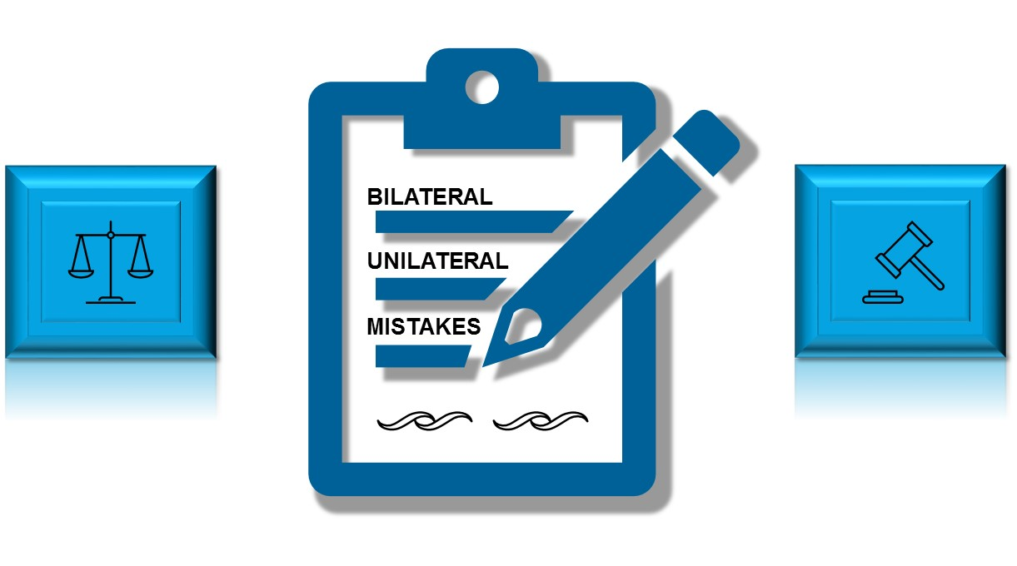
Why Does Voluntary Consent Matter?
Scenario: Jack meets Tony, a roofer, at Home Depot and they strike up a conversation that leads to Jack hiring Tony to replace his home roof. Is Tony obligated to work for Jack?
Notes:
Have students review the concept of voluntary consent, and answer the scenario question on the slide. Students should brainstorm, and discuss what legal protocol should take place if Jack legitimately hired Tony to work on his home roof. Should Jack create a contract? Or should Tony present a contract to Jack? What should be in the contract? What if Jack discovers that Tony is unlicensed?
Answer: Responses will vary.

Slide 4

Mistakes
Contract law allows a contract to be avoided based on mistake
Unilateral mistakes
Bilateral (mutual) mistakes
  Contracts may be reformed
  When parties reasonably interpret terms differently, a contract may be reformed or rescinded
  Case Example 14.3 Raylin v. Offshore Energy Services (OES)
Notes:
Case Example 14.3 Offshore Energy Services (OES) contracted with companies to provide workers at offshore oil drilling operations. In its contract with rig operators, OES had an indemnity provisions stating that it would insure the companies for tort claims filed against them by any OES employee. Raylin Richard, an OES employee, was injured while working on an oil rig. Richard filed a personal injury suit against Anadarko Petroleum, the head of that drilling project. OES paid $2.5 million to Richard to settle the lawsuit, but OES’s insurance company, Liberty Mutual, denied coverage. Liberty took the position that the indemnity clause in the contract between OES and Anadarko, explicitly covered “subcontractors” but did not mention “contractors” like Anadarko. Both OES and Anadarko had thought that the indemnity provision applied to subcontractors and contractors, so they claimed that there had been a mutual mistake. The district court agreed and reformed the contract to include the word contractors, as well as subcontractors. Thus, Liberty Mutual had to cover the amounts OES paid.

Slide 5
Discussion
Ethical Issue
Review the Lynyrd Skynyrd feature in the text, and answer the following discussion question:
Should a surviving member of Lynyrd Skynyrd abide by a thirty-year-old consent decree?
Notes:
Have students review the Ethical Issue feature discussing the place crash of Lynyrd Skynyrd. What was decided in the courts when Artimus Pyle and Cleopatra Films decided to create a biopic about the crash, but was blocked by Ronnie Van Zant’s brother and others?
Students should discuss how terms of the decree may have been interpreted differently, and the effects this would have on parties’ understanding and actions.

Slide 6

Mistakes of Value
  Value is variable
  Contract is enforceable if mistake concerns future market value
  Example 14.4 Bev
Notes:
Example 14.4 Pablo buys a violin from Bev for $250. Although the violin is very old, neither party believes that it is valuable. Later, however, an antiques dealer informs the parties that the violin is rare, and worth thousands of dollars. Here, both parties were mistaken, but the mistake is a mistake of value, rather than a mistake of fact. Because mistakes of value do not warrant contract rescission, Bev cannot rescind the contract.

Slide 7
Knowledge Check 1
Mistakes in contracts allow it to be ____________.
        Avoided
        Reformed
        Rescinded
        All of the above
Notes:
Answer: D

Slide 8
Fraudulent Misrepresentation
Following Elements Involved:
Misrepresentation of a material fact must occur
Intent to deceive present
Innocent party must justifiably rely on misrepresentation
Party must have been harmed from misrepresentation in order to collect damages

Slide 9


Misrepresentation Has Occurred
Misrepresentation by conduct (behavior)
Statements of opinion
Misrepresentation of law
  Example 14.6 Cameron
Misrepresentation by silence
  Example 14.7 Jude
  Latent defect only
Notes:
Example 14.6 Cameron has a parcel of property that she is trying to sell to Levi. Cameron knows that a local ordinance prohibits building anything higher than three stories on the property. Nonetheless, she tells Levi, “You can build a condominium one hundred stories high if you want to.” Levi buys the land and later discovers that Cameron’s statement is false. Levi generally cannot avoid the contract, because under common law, people are assumed to know state and local laws.
Example 14.7 Jude is selling a car that has been in an accident and has been repaired. He does not need to volunteer this information to a potential buyer. If, however, the buyer asks him if the car has had extensive bodywork and he lies, Jude has committed fraudulent misrepresentation.

Slide 10
McCullough v. Allstate Property and Casualty Insurance Co.
Polling Question
In most cases involving the interpretation and application of a contract, is a party allowed to present evidence outside of the document expressing the parties’ agreement?
Yes
No
Explain your reasoning to another person or classmate.
Notes:
Have students review Case 14.1 McCullough v. Allstate Property and Casualty Insurance Co. and answer the question on the slide. Students should discuss the decision and remedy of the case, and apply the concept of contract interpretation and misrepresentation.
Answer: Responses may vary.

Slide 11


Intent to Deceive
  Scienter – “guilty knowledge”
  Innocent Misrepresentation
    Example 14.9 Bryant
  Negligent Misrepresentation
    Example 14.10 Dirk
Notes:
Example 14.9 Bryant submits an application for no-fault automobile insurance with State Farm, in which he states that he has not received any traffic citations for three years. State Farm accepts the application, and Bryant pays the premium. Soon thereafter, State Farm discovers that, one year and eight months earlier, Bryant had been cited for operating a motor vehicle while impaired. Even if Bryant’s misrepresentation on the application is an innocent mistake, State Farm can void the insurance contract and return the premium because the misrepresentation is material.
Example 14.10 Dirk, an operator of a weight scale, certifies the weight of Sneed’s commodity. If Dirk knows that the scale’s accuracy has not been checked for more than three years, his action may constitute negligent misrepresentation.

Slide 12
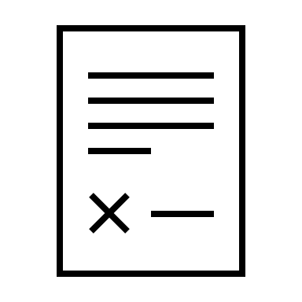
Justifiable Reliance on the Misrepresentation
Justifiable reason needed for relying on misrepresentation
Misrepresentation important factor in deceiving party to contract
If innocent party knows true facts, then reliance not justified

Slide 13
Cronkelton v. Guaranteed Construction Services, LLC
Polling Question
Did Shivley’s misrepresentation rise to a level of fraud?
Yes
No
Explain your reasoning to another person or classmate.
Notes:
Have students review Case 14.2 Cronkelton v. Guaranteed Construction Services, LLC, and answer the question on the slide. Students should discuss the decision and remedy of the case, and apply the concept of relying on representation.

Slide 14

Injury to the Innocent Party
Harm unnecessary to rescind contract
Proof of harm required to recover damages universally
Punitive and exemplary damages may be awarded
Claim often included in contract disputes

Slide 15
Group Breakout Discussion
Adapting the Law to the Online Environment
The Problem of “Contract Cheating”
Josh pays AcademicShark.com $50 for an essay on the biblical references in Moby Dick. The website promises “a top-notch grade,” and includes a disclaimer as described above. Josh hands in the Moby Dick paper without making any changes and receives a C+.
Does he have any recourse under contract law should he want a refund?
Notes:
Break students out into small groups, and have them review the Adapting the Law to the Online Environment feature. Ask students to discuss the scenario and question posed on the slide. Students may use their smart phones to conduct further research.
The instructor can also provide feedback, and discuss elements of online fraud related to academic integrity especially dealing with essay writing.

Slide 16

Undue Influence and Duress
Contract lacks voluntary consent and is voidable
One party dominates the other unfairly
A presumption of undue influence in certain situations
  Example 14.11 Erik
Duress includes illegal threats, blackmail, and extortion to induce consent
Duress is a defense to contract enforcement, and grounds for rescission
Notes:
Example 14.11 Erik is the guardian for Kinsley, his ward. On her behalf, he enters into a contract from which he benefits financially. If Kinsley challenges the contract, the court will likely presume that the guardian has taken advantage of his ward. To refute this presumption, Erik has to show that he made full disclosure to Kinsley, and that consideration was present. He must also show that Kinsley received, if available, independent and competent advice before completing the transaction. Unless the presumption can be rebutted, the contract will be rescinded.

Slide 17
Knowledge Check 2
The essential feature of undue influence is that the party being taken advantage of, does not exercise free will in entering a contract.
True
False
Notes:
Answer: True

Slide 18

Knowledge Check Video: Mistakes

Slide 19
Knowledge Check Video Question
In business contracts, mistakes that can exist are:
                Mistakes of value
                Mistakes of fact
                Neither A nor B
                Both A and B
Notes:
Answer: D

Slide 20
Video Debrief: Mistakes
Do you think it was fair for Jones to rescind the contract over Bessie’s pregnancy on claims of mutual mistake?
Share your opinion applying the concept of mutual mistakes in contracts.
Notes:
Students are welcome to conduct further research on their devices to learn more about mutual mistakes in contract cases.
Answer: Responses may vary.

Slide 21
Self-Assessment
What concepts did you find difficult, and thus need to review?
How might the topics in this chapter come up in the future in your personal (or work) life?
How can you use your personal (or work) experience to contribute for a class discussion on the topics in this chapter?
Which topics would you like to independently learn more about?

Slide 22
Summary
Now that the lesson has ended, you should have learned how to:
Define voluntary consent.
Describe the difference between bilateral and unilateral contracts.
Identify the various forms of mistake in the creation or execution of contracts.
Explain intent to deceive.
Explain how duress affects a contract.

