Slide 1
The Dynamic Duo: Credit and Sales
A Look At Best Practices In The Relationship

Slide 2
FOUR STRATEGIC AREAS
Evaluating Current State of the Relationship
Formulating Efficiencies into the Relationship
Communicating Through Open Trusted Relationships
Collaborating Through Mutually Beneficial Relationships

Slide 3
EVALUATING THE RELATIONSHIP
Why Develop?
Benefits far outweigh any fear to pursue!
Acquiring customers and getting paid timely=PROFITABILITY
Makes easier to do business with / placing you ahead of competition
Demonstrates cohesiveness to upper management
Establishes TRUST
Notes:
RESPECTED / REJECTED: Pole your audience about their relationship with sales team and drill down on answers given…
Why Develop…Two facets that a company must do well to survive…Acquiring customers and getting paid timely
Benefits - Customer overall service and support provided – Creates synergy makes it easier for customer to do business with you
How well does credit and sales communicate between each other as well as among themselves?
How well does credit and sales trust each other as well as among themselves? Trust is "the assured reliance on the character, ability, strength, or truth of someone"². According to numerous articles, trust in the relationship is the key driver to the success of the two functions.

Slide 4
EVALUATING THE RELATIONSHIP
ROOT causes for struggle?
Does SALES really have CREDIT’S best interest at heart?
Avoid interpreting ACTIONS as MOTIVE…
Opposites Attract or Attack?
Perception is created by points of view!
Notes:
ROOT CAUSE - Too Much Credit Oversight = Impeding Sales . Too Much Sales = High Bad Debt Losses . Find Balance by offering creative credit solutions
ACTIONS as MOTIVE – Give benefit of the doubt…Get past thinking sales intentionally tries to skirt credit requirements by reinforcing that omissions result in invoicing delays and thus their commission
No longer ATTACK but instead ATTRACT in this case – The Push / Pull is generally good for business as one without other leads to FAILURE
PERCEPTION: Elephant picture changes when head is tilted . From challenging climb to stumbling while simply walking. Same with Credit n Sales what may seem as easy as walking might be viewed as a real challenge and visa versa.

Slide 5
EVALUATING THE RELATIONSHIP
Strip away EMOTIONS to reach Commonalities!
It Takes work and effort to be Respected
Ask Questions….What can CREDIT do? & Vice Versa
Assembly required!
Notes:
You must be a willing participant in order to develop mutual respect with sales team
Both having something in common “working for same company” and making decisions you feel is most beneficial you already have key component to forging.
Ask questions and dig deeper…hobbies for instance many contract have been finalized on golf course, what about favorite teams? Already knowing their location makes it easy. Once strip away corporate veils then able to get honest feedback on questions and become viewed as ADVOCATE
Each Credit / Sales relationship is unique…some are assembled and may only require minor adjustments, while others are fresh out of the box and starting from scratch. Pole the audience…who actually looks and must locate manual before theY start of assembly and who just prefers to wing it??? Then apply to EVALUATION process.

Slide 6
FORMULATING EFFICIENCIES INTO THE RELATIONSHIP…
Respect Differing Opinions!
“SAME Team” Objective
Embrace passionate pleas and positions
Territorial is typical
Notes:
Accept differences in opinions and work together on the best solutions for the organization. Be authentic with each other and customers.
SAME Team….There is not one of us that is as smart as all of us…acknowledge objective is SUCCESS for the company you represent
Likely your Credit & Sales teams are passionate about what they do…this should be embraced and not viewed as a hurdle. Shared traits are the foundation compatibility!
Both Credit & Sales professionals have territorial tendencies and it is imperative this is fully understood to appreciate differing viewpoints and opinions.

Slide 7
FORMULATING EFFICIENCIES (Cont.)
Clearly express your views and be open to challenges
Support with FACTS but avoid sharing specifics
Reinforce importance of Mitigation tools
Above all don’t MAKE STUFF UP!
Notes:
Prior to communication with sales rep, make sure and pull together all of your supporting facts…Expect Challenges: remember sales professionals are skilled at overcoming objections and your preparedness with reinforce credibility.
Share facts in relation to evaluation steps, depth of investigation, and outcome but avoid sharing injurious opinions or specifics that sales could inadvertently share opening pathway to ECOA issues
Utilize all tools available to make an informed credit decision to mitigate collection problems later. This is a critical time for credit professionals to educate sales persons about the passion you share in helping their sales numbers as long as risk is reviewed and “Safe Credit” is exercised
A sure strength of every sales professional is their ability to sense when the are not be “shot straight” so don’t Make Stuff Up!

Slide 8
FORMULATING EFFICIENCIES (Cont.)
Responsiveness is
Timely follow through on Commitments
Get through the DIRT and mine for
Notes:
Imperative to be RESPONSIVE since Sales professionals are use to following a rigid schedule when it comes to calendars and times….they are accustomed to arriving early for appointments and appreciate prompt responses to emails and messages
Credit professional must demonstrate these same characteristics in order to achieve compatibility
Depending on level of respect, you are likely to encounter some friction and/or turbulence but the key is to stay calm and remain focused and appreciate shared passions

Slide 9
COMMUNICATING OPENLY
SALES Prevention or VALUED Extension?
Paramount to Promote Harmony with Sales and Customer Service teams
Are YOU truly listening?
What is the HOLD UP?
Notes:
Based on your relationship and willingness to work together, what departmental trait are you communicating?
By promoting Harmony amongst other departments your teams value and brand is elevated while typical stressors are minimized.
Listening has become a lost art! When discussing accounts with sales, you must direct your full attention to the conversation. Avoid entering into conversation with preconceived notions. Sales persons tend to be extremely expressive and it is important to appreciate this characteristic that enables success in their profession.
Conversely…Credit professional are analytical and instincts are to SLOW DOWN when trying to be hurried…must investigate before offering determination. It is critical for your sales team to understand and appreciate with comfort in knowing your team is not judgemental just processing due diligence.

Slide 10
COMMUNICATING CONSITENTLY:
Forging “HIGH TRUST”
Avoid “BLINDSIDING” or putting in unfavorable position
Speak “SALES” to reinforce efforts
Notes:
Forging: To create a relationship or strengthen new conditions…
Quickest way for credit professional to infuriate a sales rep is to not (timely) communicate customer issues and the rep find out while on site doing sales call. (Ask for examples from attendees) …
For instance, If you are holding orders(s) due to past due balance immediately after informing accounts payable be sure and inform sales team.
Avoid using commonly used credit words like…delinquent, past due, DSO, DBT, etc….this means nothing to your sales team so instead of communication that customer severely past due and their days beyond terms is increasing, get sales attention by saying “did you know for every 30 days beyond terms, we lose approximately 5-7% of our margin?” or “I know how important your commission is to you so I need assurance of being paid as this in essence commission for the company.

Slide 11
COMMUNICATING COLLECTIVELY:
In-person customer visits form accountability…
Schedule in conjunction with conferences, etc
BOOTS on the ground awareness
“ONE Voice”
Notes:
If budget allows schedule times to do sales calls with your representatives. This will immediately form a deeper level of trust with both sales and customer. Suddenly you will likely find customers moving you to the top of the payment pile, plus sales will have greater respect for YOU and your teams checks and balances.
Extending annual conference trips a few days is a cost effective way to perform in-person visitations and develop rapport with your customers.
Ask for tour and pay close attention to business condition, associates demeanor, and how many empty cubes/offices. Also, it able make note how much or your and other suppliers inventory is shelved. Pay close attention to any awards as this is tell as to who is their largest customer and if represents over 20% of revenues would be catastrophic if lost!
Make sure and affirm (with your body language/simple nods) what your sales person is sharing…remember you are a guest…and this is your chance to convey how important their partnership is to you

Slide 12
COLLABORATING EFFECTIVELY:
CLEAR AND COMPELLING EXPECTATIONS
Emphasize RISK mitigation Tools
Convey Creativity
Fiduciary Interest Defenders
Notes:
Train sales to understand the importance of obtaining up front – Signed Credit Agreement, Sales Tax Exempt Certificate, Personal Guaranty, Security Interest, etc
Ask sales rep for list of customers they will be visiting and perform cursory check in advance. Enabling sales to walk into new customer and inform them they have been pre-approved for terms and credit limit empowers. This unique demonstration of creativity reinforces extension of sales mentality
SALES & CREDIT are paramount for a company to not just survive but THRIVE. Each cannot exist without the others success and combined are Fiduciary Interest Defenders!

Slide 13
COLLABORATING EFFECTUALLY:
REINVENTING IMAGE
Profit Center Perception
Unleashing Trapped Cash
Put on your “SALES HAT”
Notes:
Change the perception for you and your team from having a dreadful job of dialing for dollars to a “Profit Center”, it all begins by aligning with sales and putting into motion the ideas that have been shared
UNLEASHING TRAPPED CASH:
Once value is established then you can be appreciated for the importance of your team when making sure proper documents are retrieved and only extended terms can be offered with you and your teams approval
Important to convey the amount of profit margin lost when terms are given. For instance sales understands if you advise that an additional 30 days can cost anywhere from 3 – 5% of margin. Also, make sure when dealing with a discounting customer no additional days are squeezed. Example customer extended 2% 15, Net 30 and chronically pays only 5 days slow or 20 days is in essence costing an additional 2% margin
“SALES HAT”
When sales approaches you about offering extended terms due to size or specialized order advise you appreciate the customer placing such a sizable order but actually need it to be increased in order to offer special terms. Now not only have you avoided denying your sales persons request, your setting stage for more commission and cash by using terms incentive. Quick way to become sales persons best friend!

Slide 14
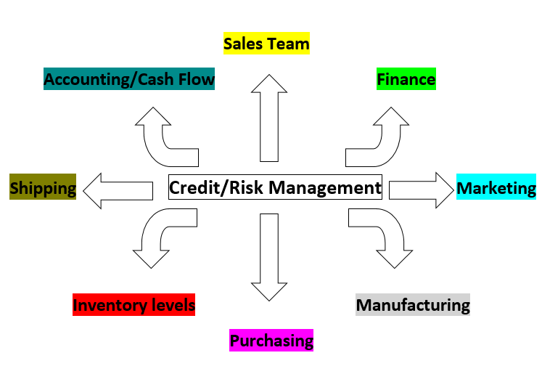
Notes:
Credit/Risk Management is arguably the most impactful department on a companies health!
We have already outlined the impact and importance to your sales department, but the same can be said for:
Finance, if the credit team does not perform then significant delinquency could affect companies banking relations by exceeding preset debt ratios and percentages / which could result is struggles to secure additional capital through borrowing, etc
Marketing, For many companies their marketing and communication department has significant budget requirements and requires money for success. It funds are not available then likely something is cut.
Manufacturing, If your company manufactures then you understand the importance of maintaining consistent fulfillment of whatever hard goods your manufacturing team requires. Once again lack of financial cash results in either delays or hard choices.
Purchasing, Simple no CASH no purchasing power….If this area is affected then you run into the problem of not obtaining necessary products to produce sales and thus cash
Operations/Inventory Levels, Holding inventory requires a lot of CASH…Inventory management affects both your sales and procurement teams. Too little inventory not able to satisfy customer needs and too much can lead to a distressed position
Shipping, Credit team can have direct affect if proper risk management and collections are not exercised than a customers order(s) may be held due to delinquency or exceeding limit…this in turn could create additional stress on shipping terms make sure your products are received by in hands need date.
Accounting, bottom line lack of cash means delay or “cherry picking” who gets paid which in turns affects your companies credit rating and potentially ability to purchase on terms. Once again is payables grow to beyond certain aging levels and percentages, your banking relations are directly affected, especially if loan payments are missed and covenant are violated.

Slide 15
CONCLUSION
Together we are stronger. Together we grow our business.

Slide 16
QUESTIONS? / COMMENTS?

